Slide 1

MODERN AI WITH ZERO CODING!

Slide 2

CARDIOVASCULAR DISEASE DETECTION WITH DATAROBOT AI
EASY
ADVANCED

Slide 3
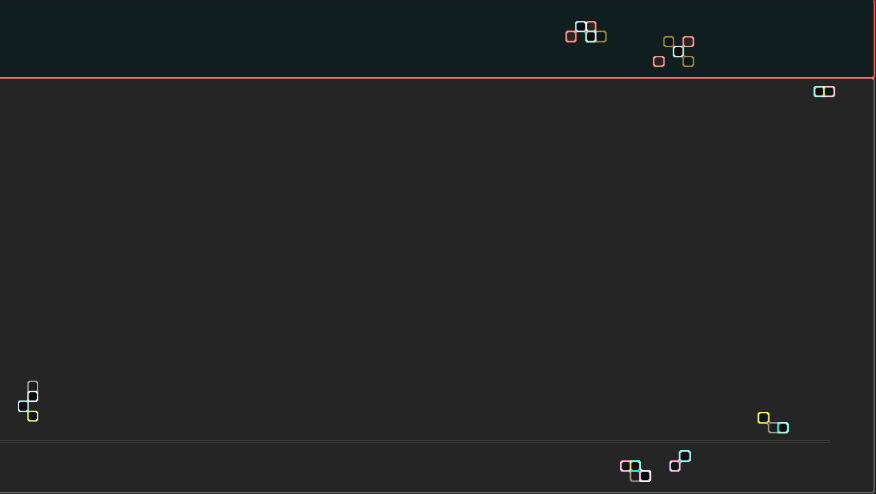
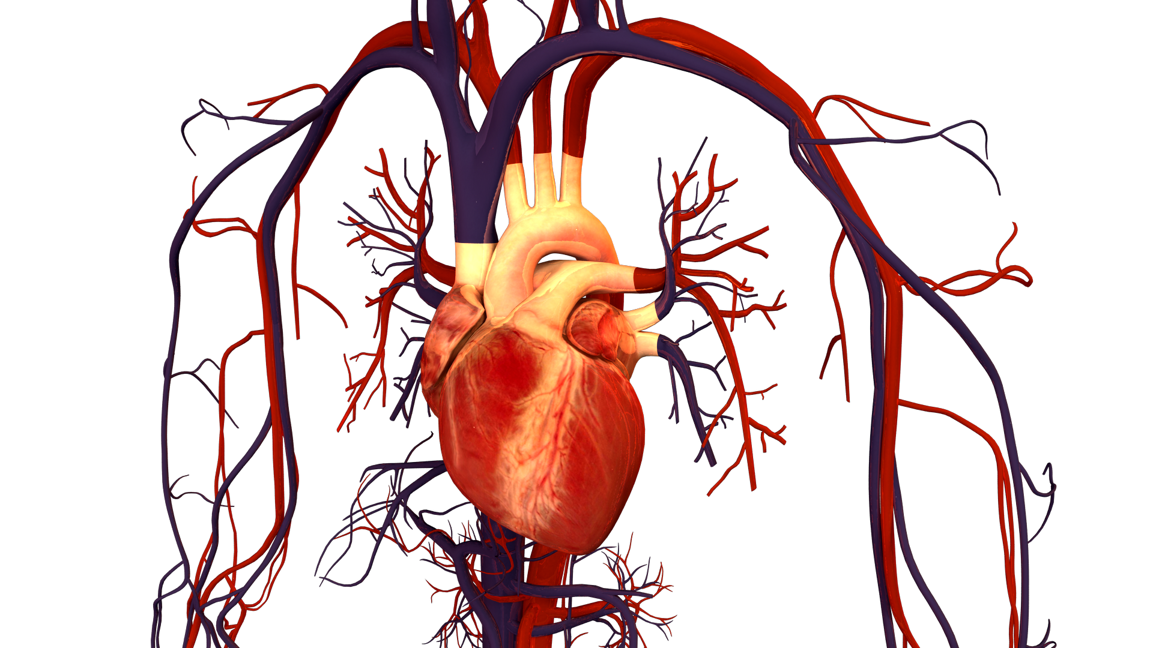
CARDIOVASCULAR DISEASE DETECTION
Aim of the problem is to detect the presence or absence of cardiovascular disease in person based on the given features.
Features available are:
Age | Objective Feature | age | int (days)
Height | Objective Feature | height | int (cm) |
Weight | Objective Feature | weight | float (kg) |
Gender | Objective Feature | gender | categorical code |
Systolic blood pressure | Examination Feature | ap_hi | int |
Diastolic blood pressure | Examination Feature | ap_lo | int |
Cholesterol | Examination Feature | cholesterol | 1: normal, 2: above normal, 3: well above normal |
Glucose | Examination Feature | gluc | 1: normal, 2: above normal, 3: well above normal |
Smoking | Subjective Feature | smoke | binary |
Alcohol intake | Subjective Feature | alco | binary |
Physical activity | Subjective Feature | active | binary |
Presence or absence of cardiovascular disease | Target Variable | cardio | binary |
Note:
Objective: factual information;
Examination: results of medical examination;
Subjective: information given by the patient.
Data Source: https://www.kaggle.com/sulianova/cardiovascular-disease-dataset
Image Source: https://commons.wikimedia.org/wiki/File:Human_Heart_and_Circulatory_System.png

Slide 4
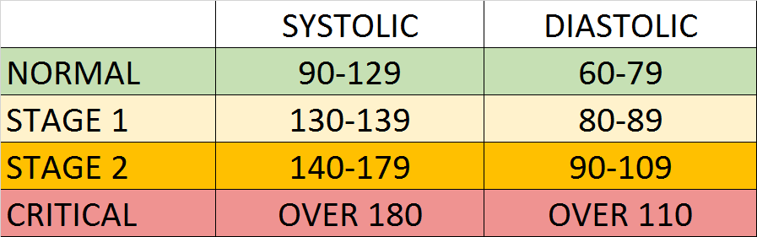
BLOOD PRESSURE 101
Blood Pressure notes:
Blood pressure is represented by 2 numbers systolic and diastolic (ideally 120/80 mm Hg).
These two number are critical in assessing the heart health.
The top number represents systolic and the bottom number representing the diastolic.
Systolic pressure indicates the blood pressure in the arteries when the blood is pumped out of the heart.
The diastolic pressure indicates the blood pressure between beats (at rest, filling up and ready to pump again).
If these numbers are high, that means that the heart is exerting more effort to pump blood in the arteries to the body.
Photo Source: https://commons.wikimedia.org/wiki/File:Hypertension_ranges_chart.png

Slide 5

CHOLESTEROL 101
Cholesterol notes:
Cholesterol is a waxy material found in humans blood.
Normal level of cholesterol is necessary to ensure healthy body cells but as these levels increase, heart disease risk is elevated.
This waxy material can block the arteries and could result in strokes and heart attacks.
Healthy lifestyle and regular exercises can reduce the risk of having high cholesterol levels.
More information: https://www.mayoclinic.org/diseases-conditions/high-blood-cholesterol/symptoms-causes/syc-20350800
Photo Credit: https://commons.wikimedia.org/wiki/File:Clogged_Heart_Artery.jpg

Slide 6
GLUCOSE 101
Glucose notes:
Glucose represents the sugar that the human body receive when they consume food.
Glucose means “sweet” in Greek.
Insulin hormone plays a key role in moving glucose from the blood to the body cells for energy.
Diabetic patients have high glucose in their blood stream which could be due to two reasons:
They don’t have enough insulin
Body cells do not react to insulin the proper way
Read more: https://www.webmd.com/diabetes/glucose-diabetes

Slide 7



READING TIME & QUIZ: AI FOR CARDIOVASCULARE DISEASE
Please read the article below and answer the following quiz
Link to Article: https://www.ncbi.nlm.nih.gov/pmc/articles/PMC6748906/
30 MINS
10 MINS

Slide 8
DATAROBOT AI DEMO – PART #1: SIGNUP AND TRAINING DATA UPLOAD
EASY
ADVANCED

Slide 9

DATA ROBOT AI
DataRobot is the leading end-to-end enterprise AI platform that automates the process of building, training and deploying AI models at scale.
GO TO LINK: HTTPS://WWW.DATAROBOT.COM/ AND CLICK ON FREE TRIAL

Slide 10

DATAROBOT AI
ENTER YOUR INFORMATION

Slide 11

DATAROBOT AI
YOU’LL RECEIVE A CONFIRMATION E-MAIL TO START YOUR 14-DAY TRIAL.

Slide 12
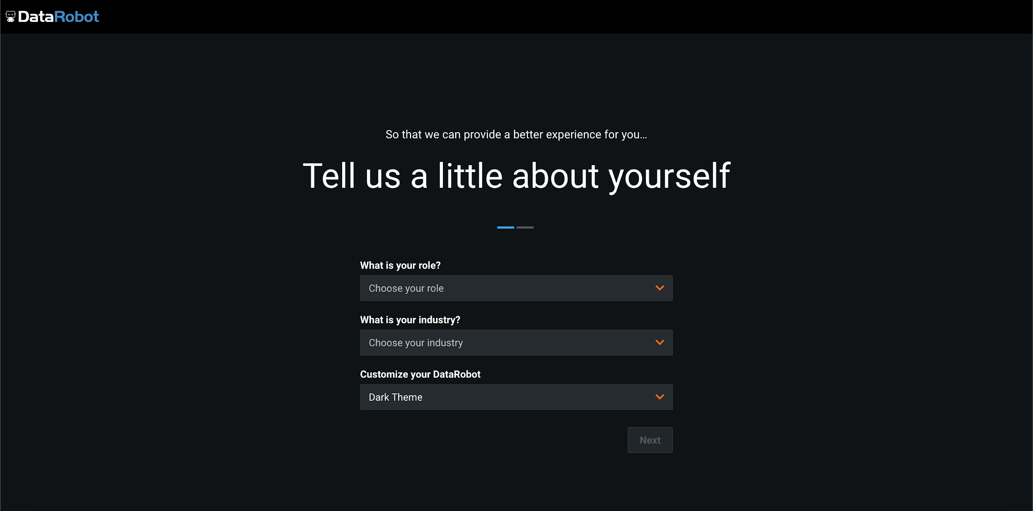
DATA ROBOT AI
FILL OUT YOUR ROLE, INDUSTRY AND THEME PREFERENCE

Slide 13
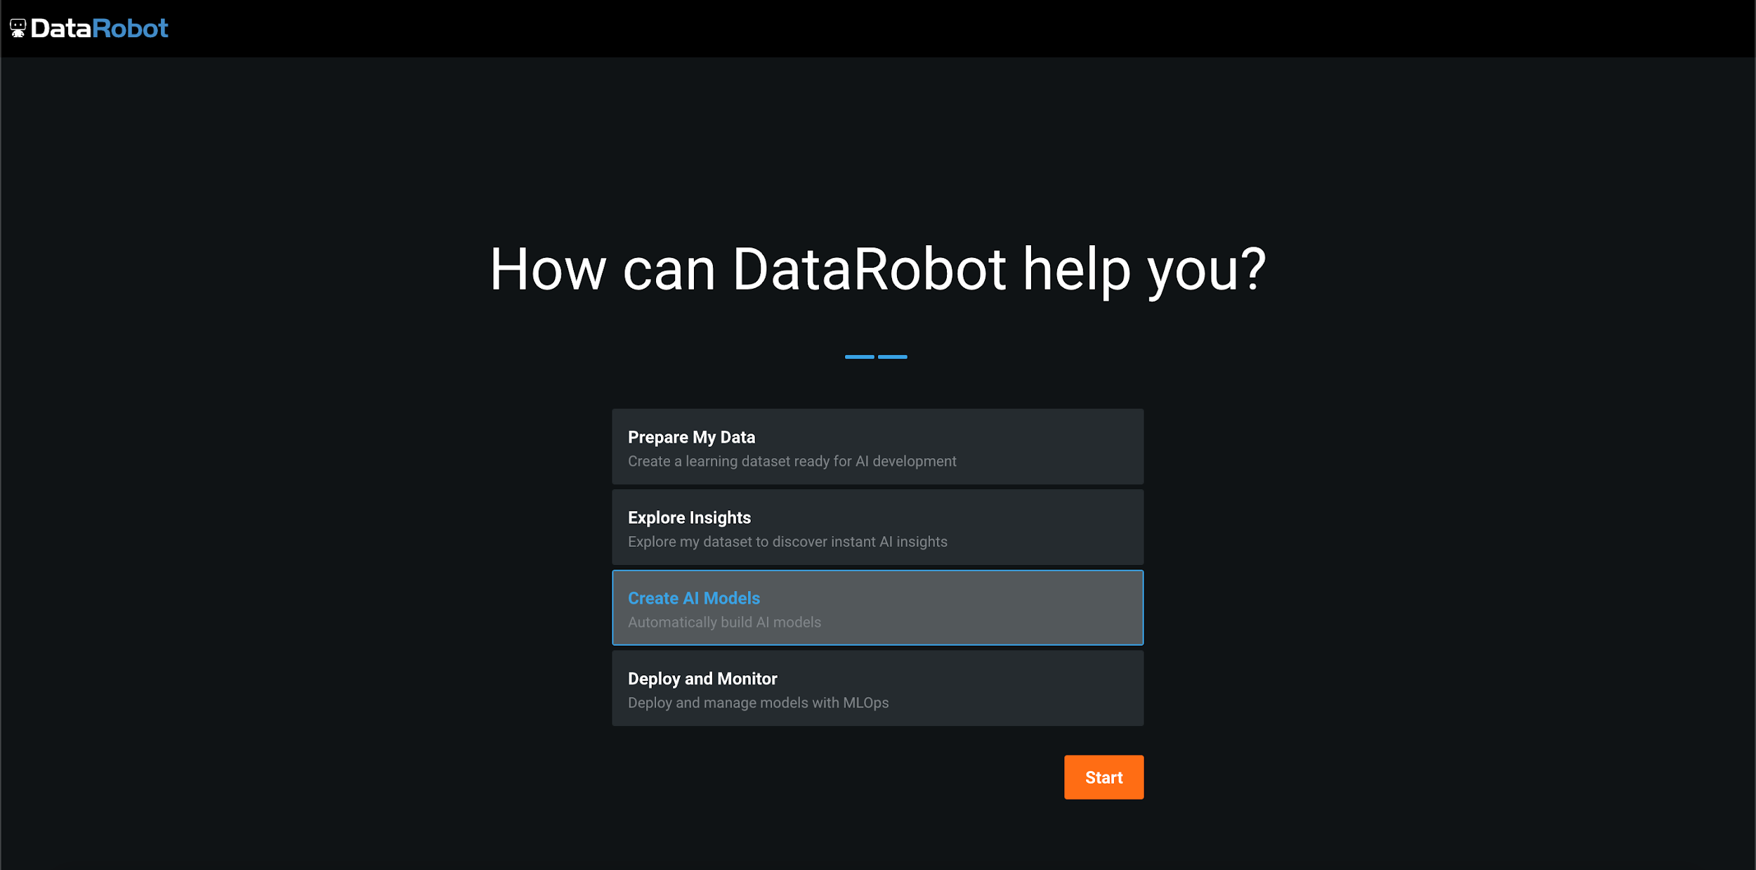
DATA ROBOT AI
SELECT CREATE AI MODELS

Slide 14
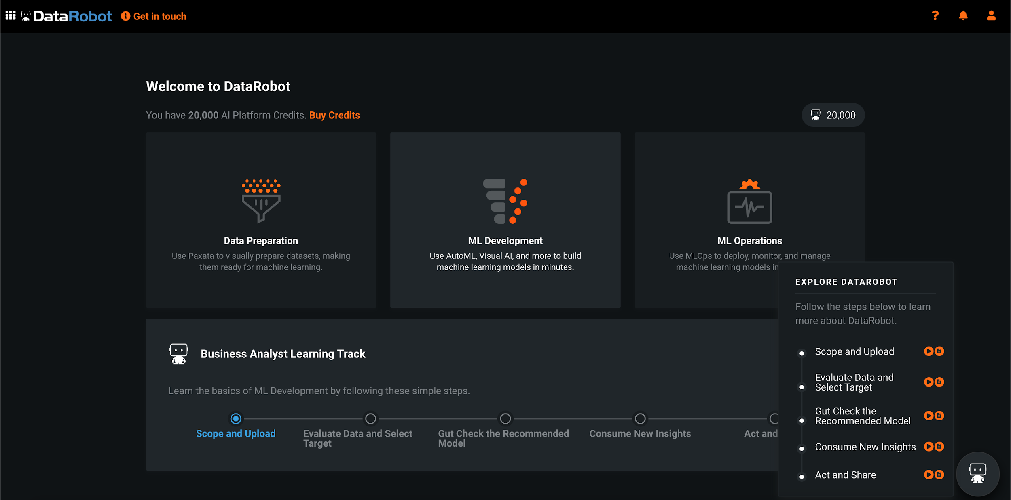
DATA ROBOT AI
AFTER YOU’VE SIGNED UP, CLICK ON ML DEVELOPMENT TILE

Slide 15
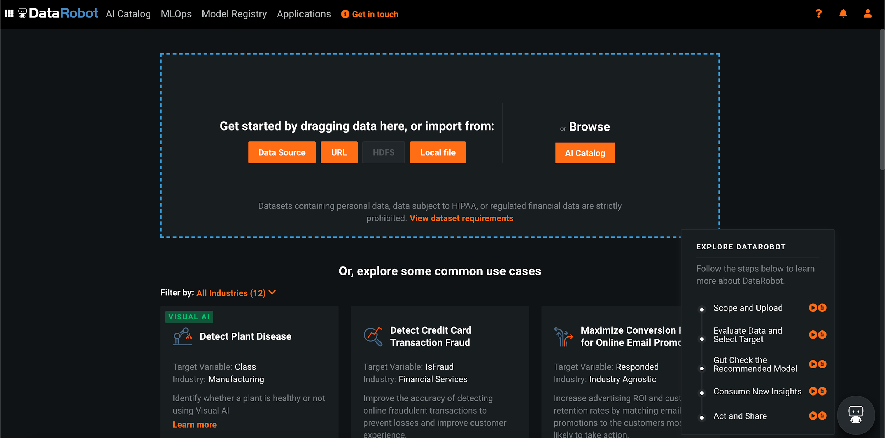
DATA ROBOT AI
CLICK ON LOCAL FILE TO UPLOAD THE DATA.

Slide 16
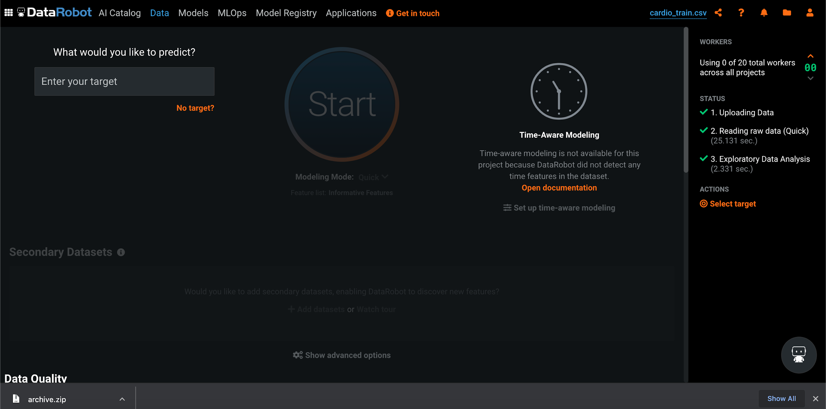
DATA ROBOT AI
ONCE YOU’VE UPLOADED YOUR LOCAL FILE, YOU WILL BE ABLE TO SEE THIS SCREEN.

Slide 17
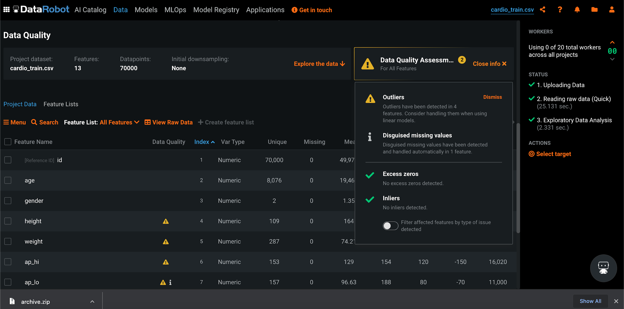
DATA ROBOT AI
AFTER SCROLLING THROUGH, YOU’LL FIND SOME DATA QUALITY ALERTS. SINCE THEY ARE NOT SIGNIFICANT AT THIS TIME, WE WILL IGNORE THEM.

Slide 18
DATAROBOT AI DEMO – PART #2: TARGET SELECTION AND EXPLORATORY DATA ANALYSIS
EASY
ADVANCED

Slide 19
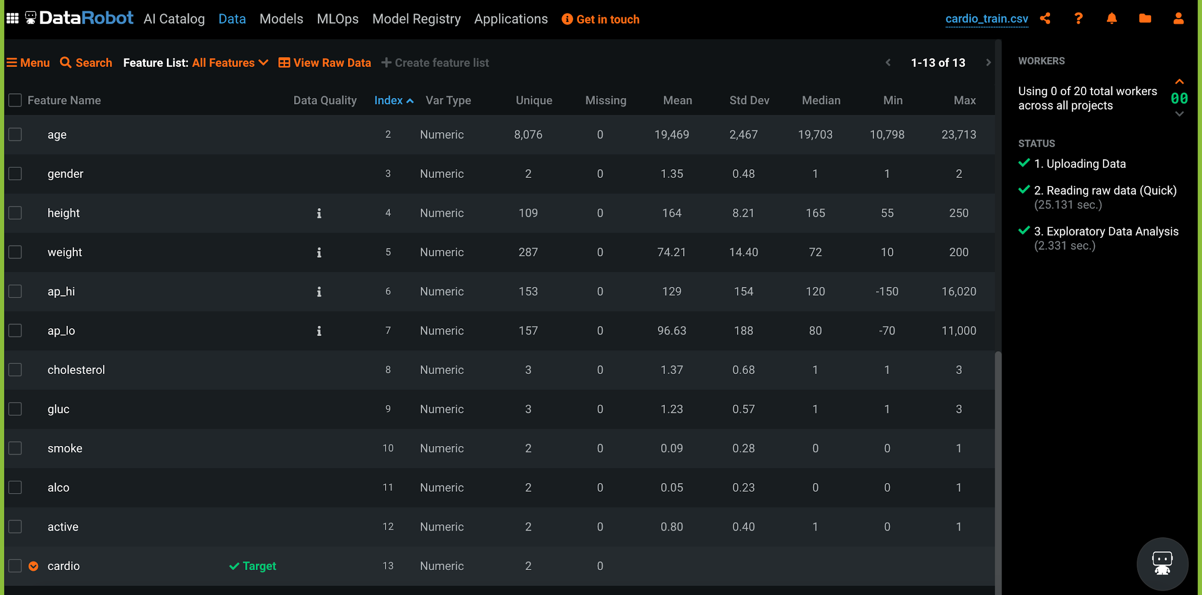
DATA ROBOT AI
TO SELECT THE TARGET, MOVE THE CURSOR NEAR THE REQUIRED COLUMN AND CLICK ON ‘MAKE AS TARGET’
YOU CAN FURTHER EXPLORE EACH FEATURE BY CLICKING ON EACH COLUMN NAME.

Slide 20
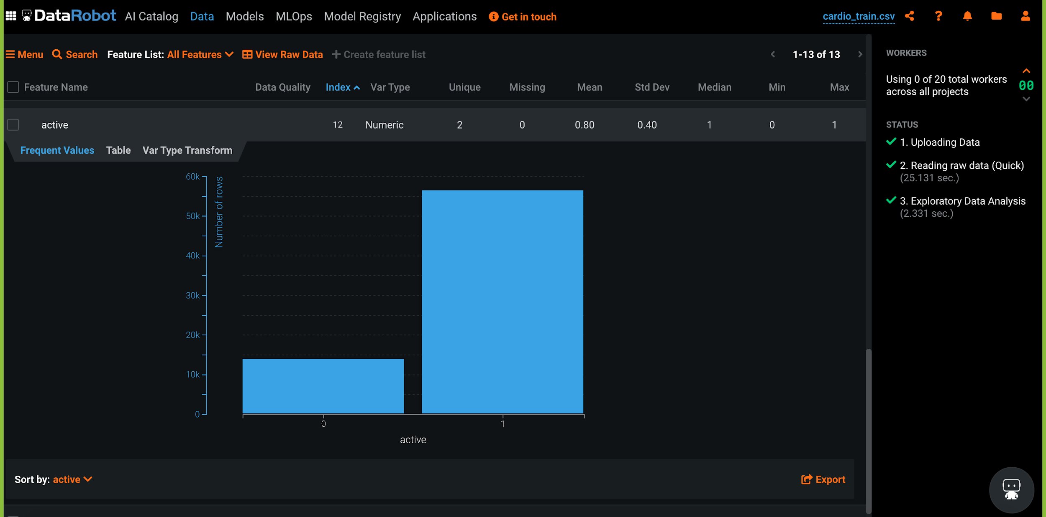
DATA ROBOT AI

Slide 21
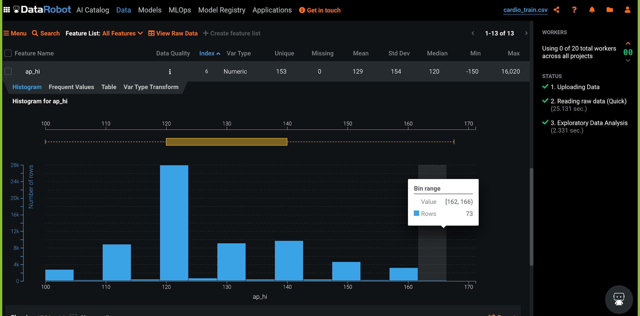
DATA ROBOT AI

Slide 22
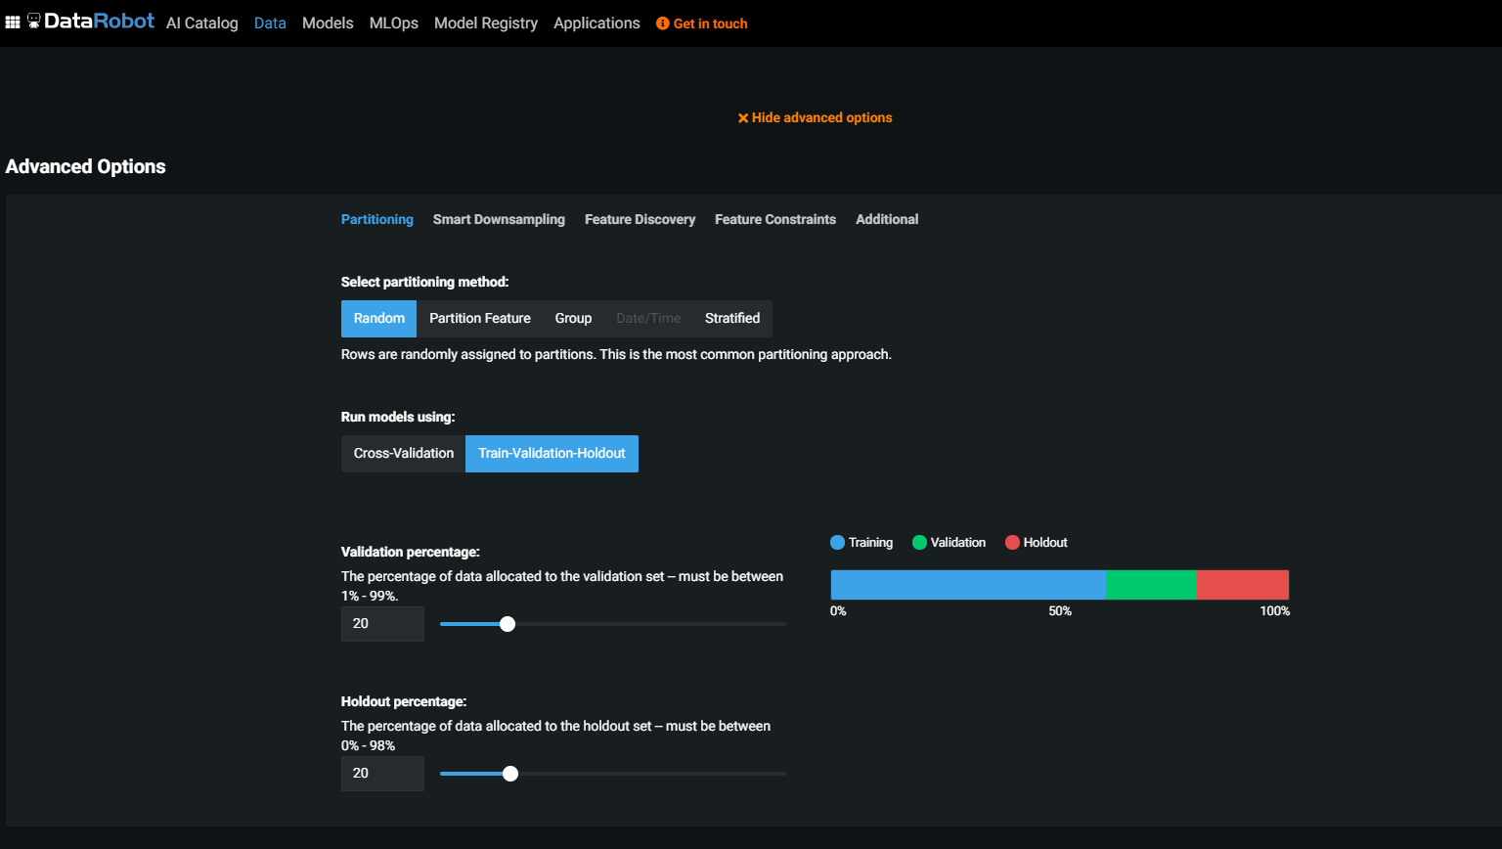
DATA ROBOT AI
AFTER EXPLORING THE FEATURES, BELOW THE START BUTTON, YOU CAN FIND THE “ADVANCED OPTION”, YOU CAN SPECIFY THE NUMBER OF FOLDS FOR VALIDATION AND CHOOSE THE HOLDOUT PERCENTAGE.
Additional reading materials: https://www.datarobot.com/wiki/training-validation-holdout/

Slide 23
DIVIDE DATA INTO TRAINING AND TESTING
Data set is generally divided into 80% for training and 20% for testing.
Sometimes, we might include validation dataset as well and then we divide it into 60%, 20%, 20% segments for training, validation, and testing, respectively (numbers may vary).
TRAINING DATASET
60%
1. Training set: used for gradient calculation and weight update.
2. Validation set: used for cross-validation to assess training quality as training proceeds. Cross-validation is implemented to overcome over-fitting which occurs when algorithm focuses on training set details at cost of losing generalization ability.
3. Testing set (Holdout dataset): used for testing final trained model.
VALIDATION DATASET
20%
TESTING DATASET
20%

Slide 24
DATAROBOT AI DEMO – PART #3: MODEL TRAINING & FEATURE IMPORTANCE
EASY
ADVANCED

Slide 25
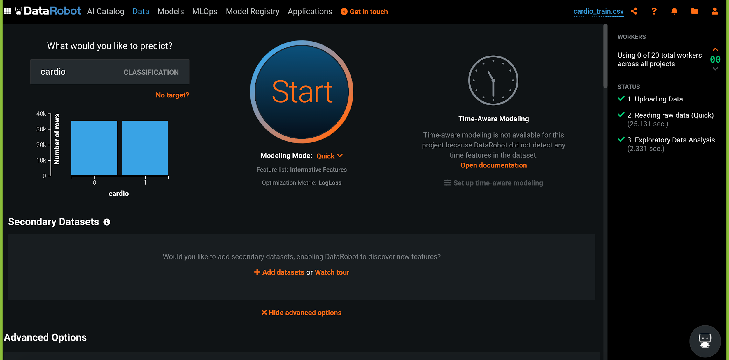
DATA ROBOT AI
NOW CLICK ON THE START BUTTON TO BEGIN YOUR TRAINING.

Slide 26
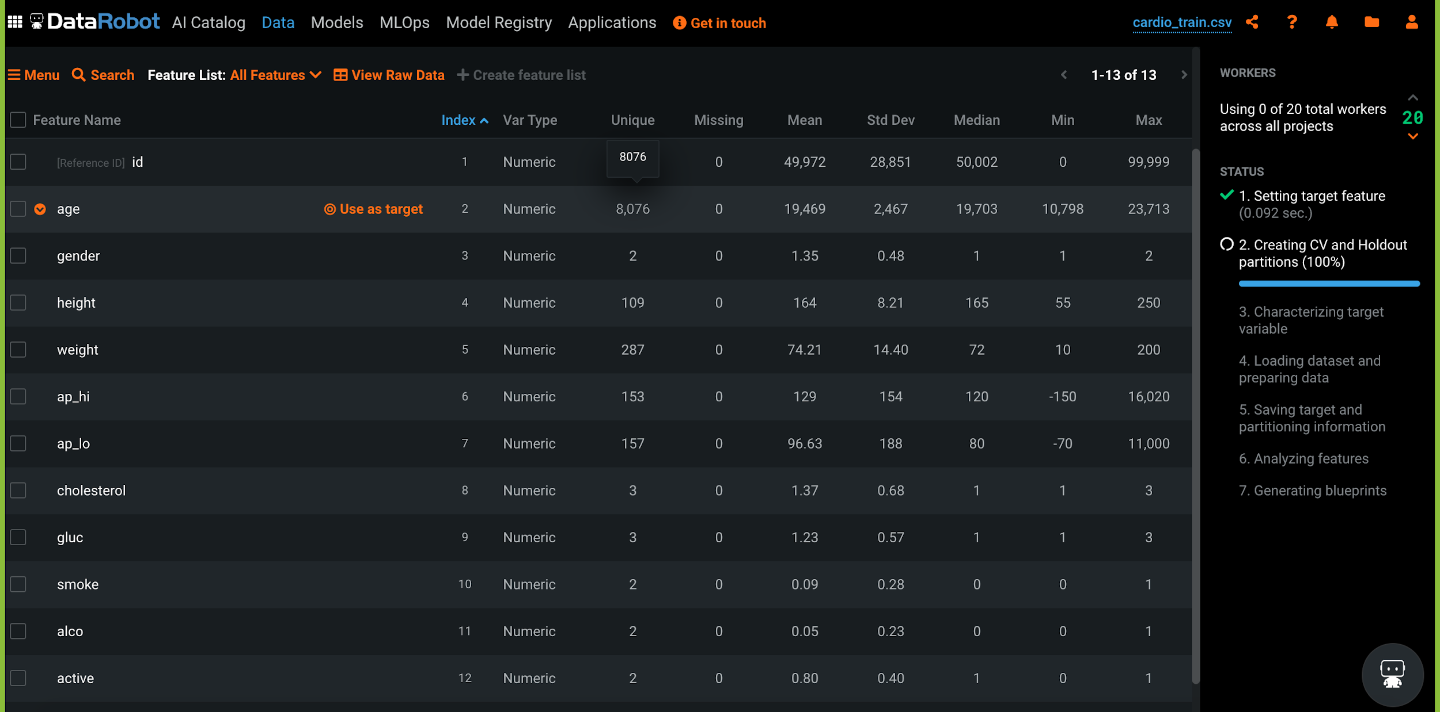
DATA ROBOT AI
NOW, YOU CAN SEE THE PROGRESS OF YOUR TRAINING IN THE SIDE BAR.

Slide 27
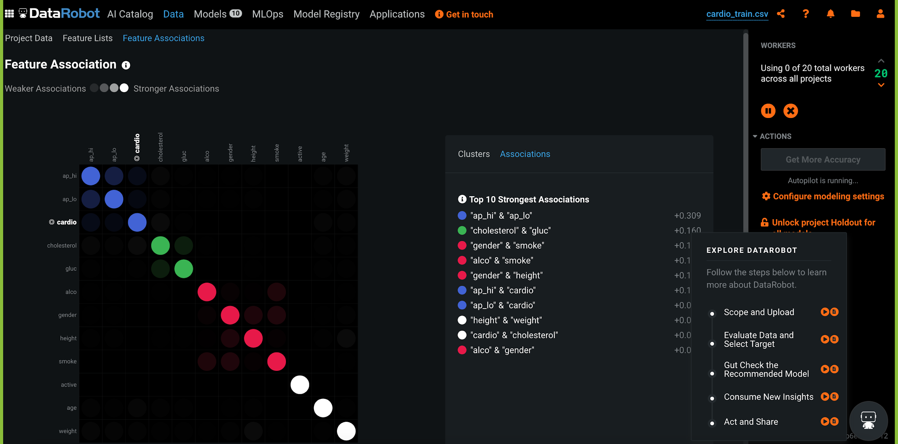
DATA ROBOT AI
WHILE THE TRAINING IS IN PROGRESS, YOU CAN SEE THE ASSOCIATION BETWEEN FEATURES BY CLICKING ON FEATURE ASSOCIATION BOX.

Slide 28
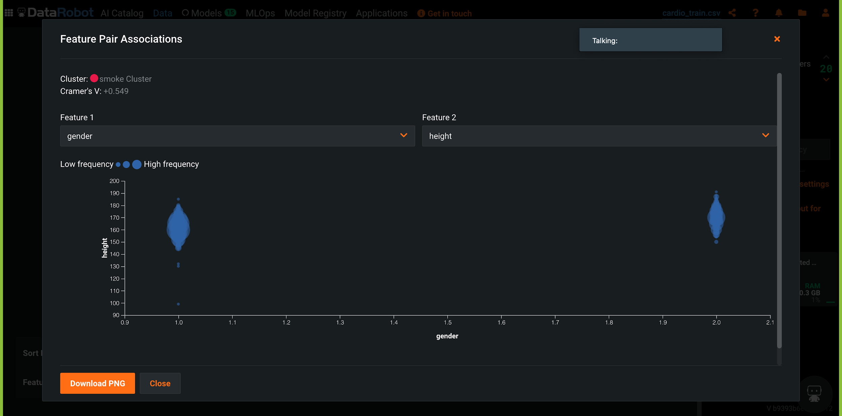
DATA ROBOT AI
BY CLICKING ON FEATURE ASSOCIATION PAIRS, YOU CAN SEE A MUCH CLEARER ASSOCIATION BETWEEN TWO FEATURES.

Slide 29
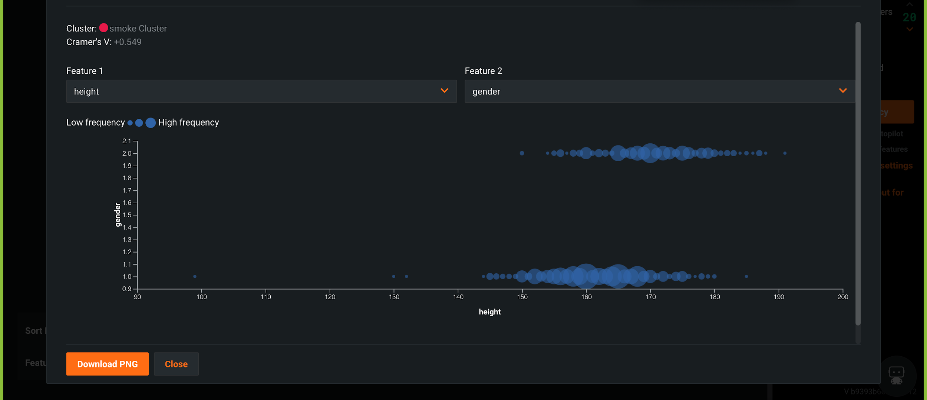
DATA ROBOT AI

Slide 30
PRECISION, RECALL, ROC, AND AUC
EASY
ADVANCED

Slide 31
CLASSIFICATION MODEL KPIs
TRUE CLASS
Classiﬁcation Accuracy = (TP+TN) / (TP + TN + FP + FN)
Misclassiﬁcation rate (Error Rate) = (FP + FN) / (TP + TN + FP + FN)
Precision = TP/Total TRUE Predictions = TP/ (TP+FP) (When model predicted TRUE class, how often was it right?)
Recall = TP/ Actual TRUE = TP/ (TP+FN) (when the class was actually TRUE, how often did the classiﬁer get it right?)
+
-
+
TRUE +
FALSE +
PREDICTIONS
FALSE -
TRUE -
-

Slide 32
PRECISION Vs. RECALL EXAMPLE
TRUE CLASS
FACTS:
100 PATIENTS TOTAL
91 PATIENTS ARE HEALTHY
9 PATIENTS HAVE CANCER
+
-
TP = 1
FP = 1
Accuracy is generally misleading and is not enough to assess the performance of a classifier.
Recall is an important KPI in situations where:
Dataset is highly unbalanced; cases when you have small cancer patients compared to healthy ones.
+
PREDICTIONS
-
FN = 8
TN = 90
Classiﬁcation Accuracy = (TP+TN) / (TP + TN + FP + FN) = 91%
Precision = TP/Total TRUE Predictions = TP/ (TP+FP) = ½=50%
Recall = TP/ Actual TRUE = TP/ (TP+FN) = 1/9 = 11%

Slide 33
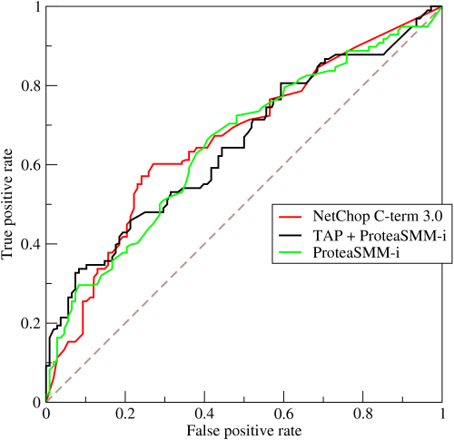
ROC (RECEIVER OPERATING CHARACTERISTIC CURVE)
ROC Curve is a metric that assesses the model ability to distinguish between binary (0 or 1) classes.
The ROC curve is created by plotting the true positive rate (TPR) against the false positive rate (FPR) at various threshold settings.
The true-positive rate is also known as sensitivity, recall or probability of detection in machine learning.
The false-positive rate is also known as the probability of false alarm and can be calculated as (1 − specificity).
Points above the diagonal line represent good classification (better than random)
The model performance improves if it becomes skewed towards the upper left corner.
Photo Credit: https://commons.wikimedia.org/wiki/File:Roccurves.png

Slide 34
AUC (AREA UNDER CURVE)
PREDICTOR #1
The light blue area represents the area Under the Curve of the Receiver Operating Characteristic (AUROC).
The diagonal dashed red line represents the ROC curve of a random predictor with AUROC of 0.5.
If ROC AUC = 1, perfect classifier
Predictor #1 is better than predictor #2
Higher the AUC, the better the model is at predicting 0s as 0s and 1s as 1s.
PREDICTOR #2
TRUE POSITIVE RATE
RANDOM PREDICTOR
FALSE POSITIVE RATE

Slide 35
DATAROBOT AI DEMO – PART #4: MODEL ASSESSMENT
EASY
ADVANCED

Slide 36
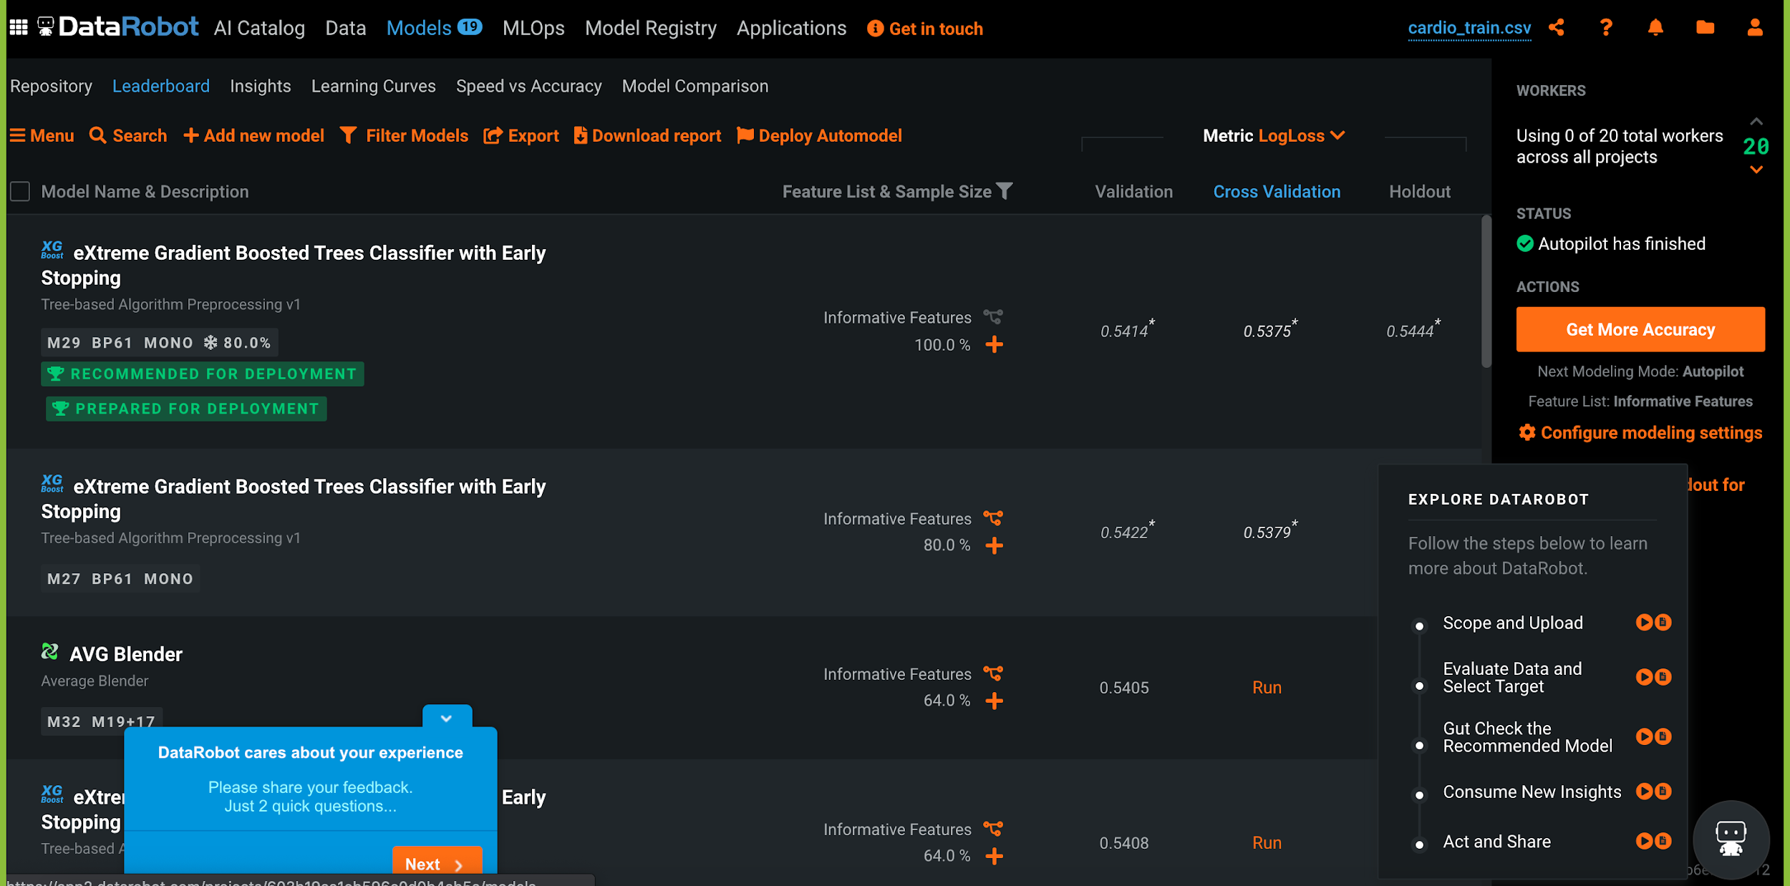
DATA ROBOT AI
ONCE THE TRAINING IS COMPLETE, YOU CAN VIEW THE PERFORMANCE OF DIFFERENT MODELS BY CLICKING ON MODELS BOX.

Slide 37
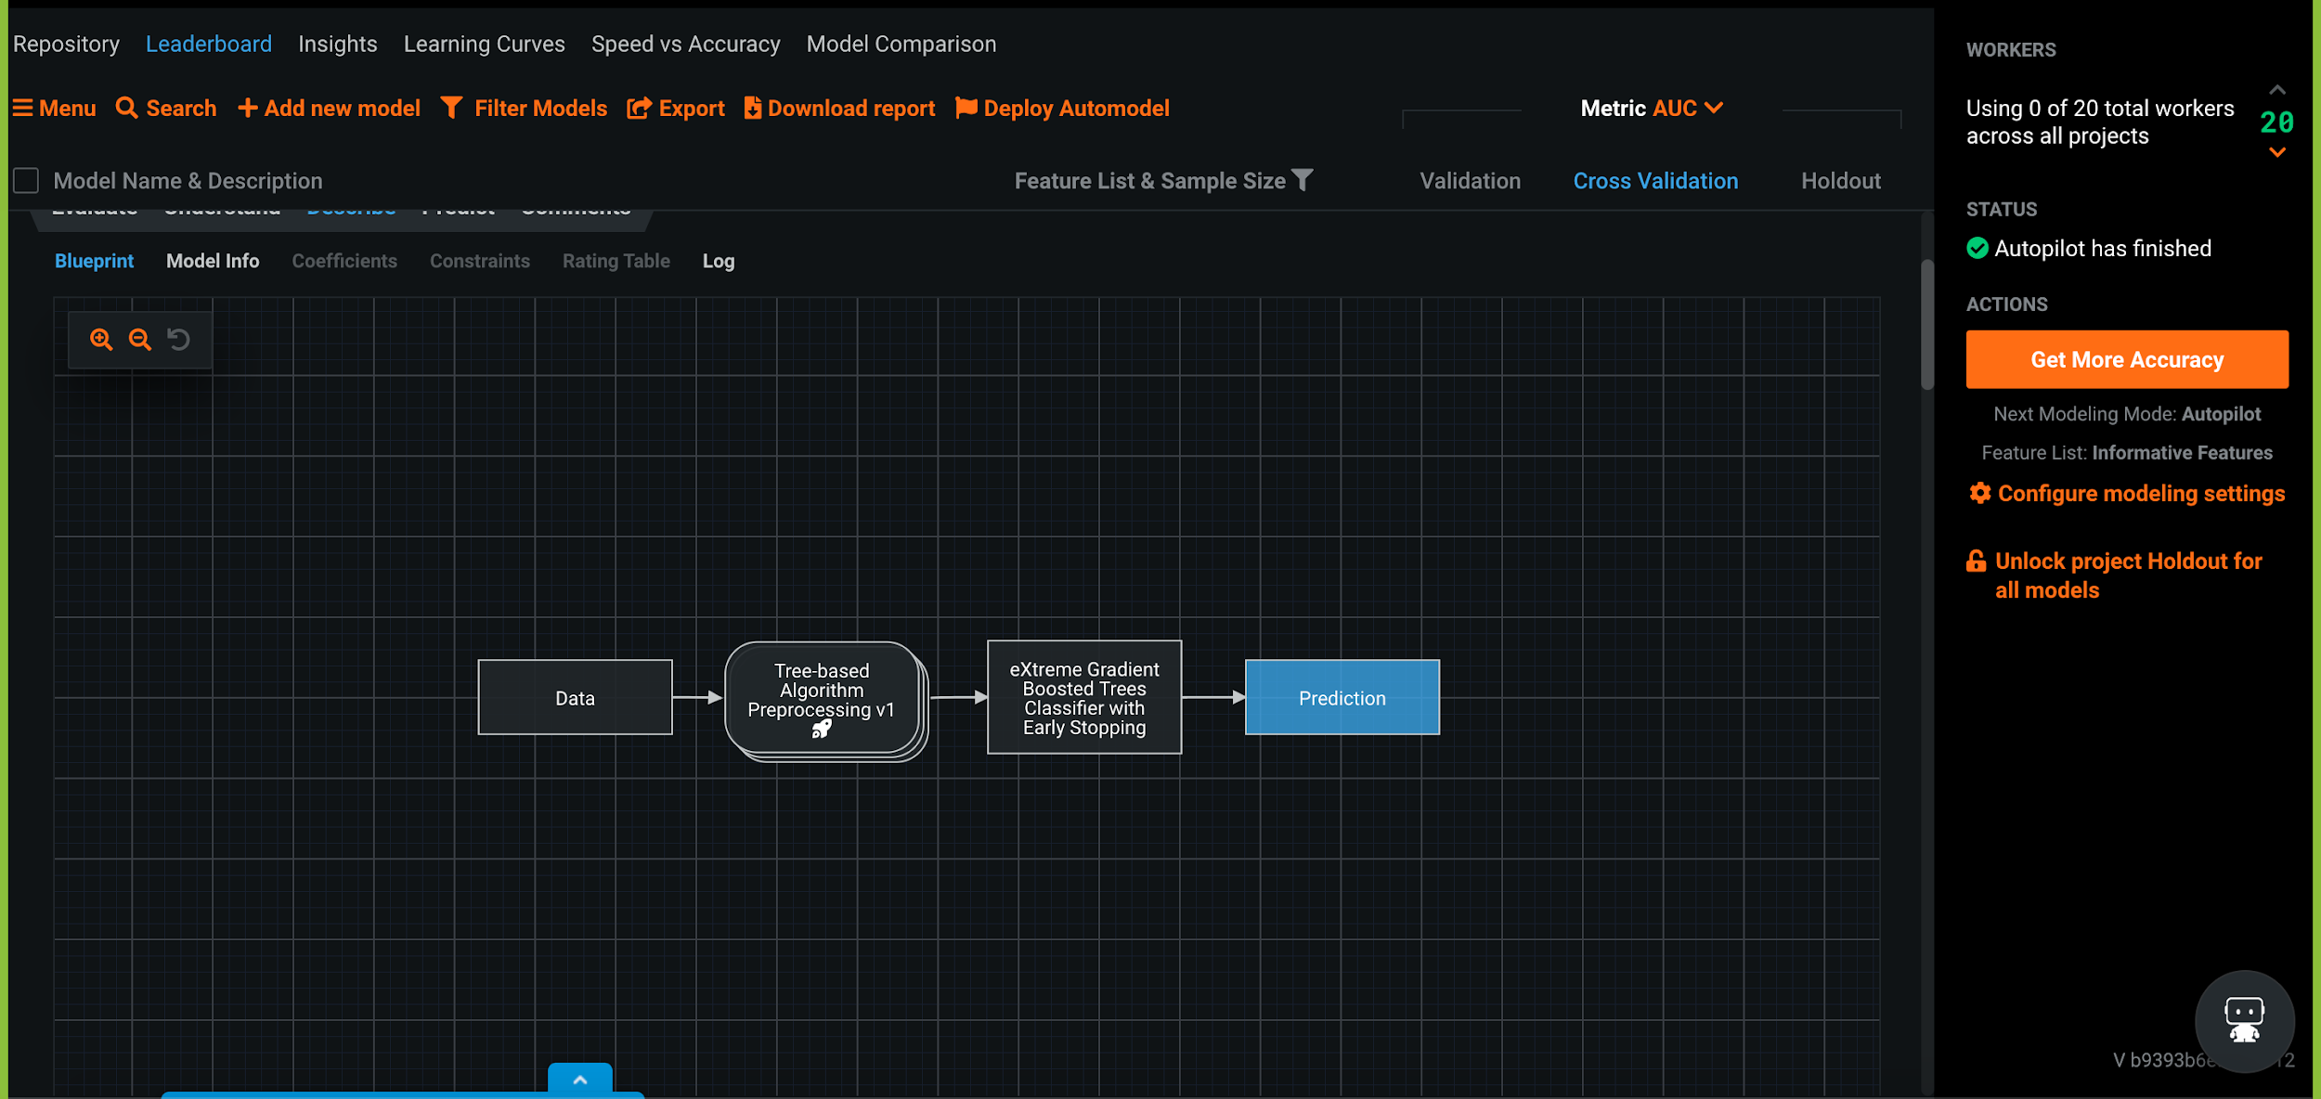
DATA ROBOT AI
YOU CAN VIEW THE ARCHITECTURE USED BY THE MODEL UNDER BLUEPRINT

Slide 38
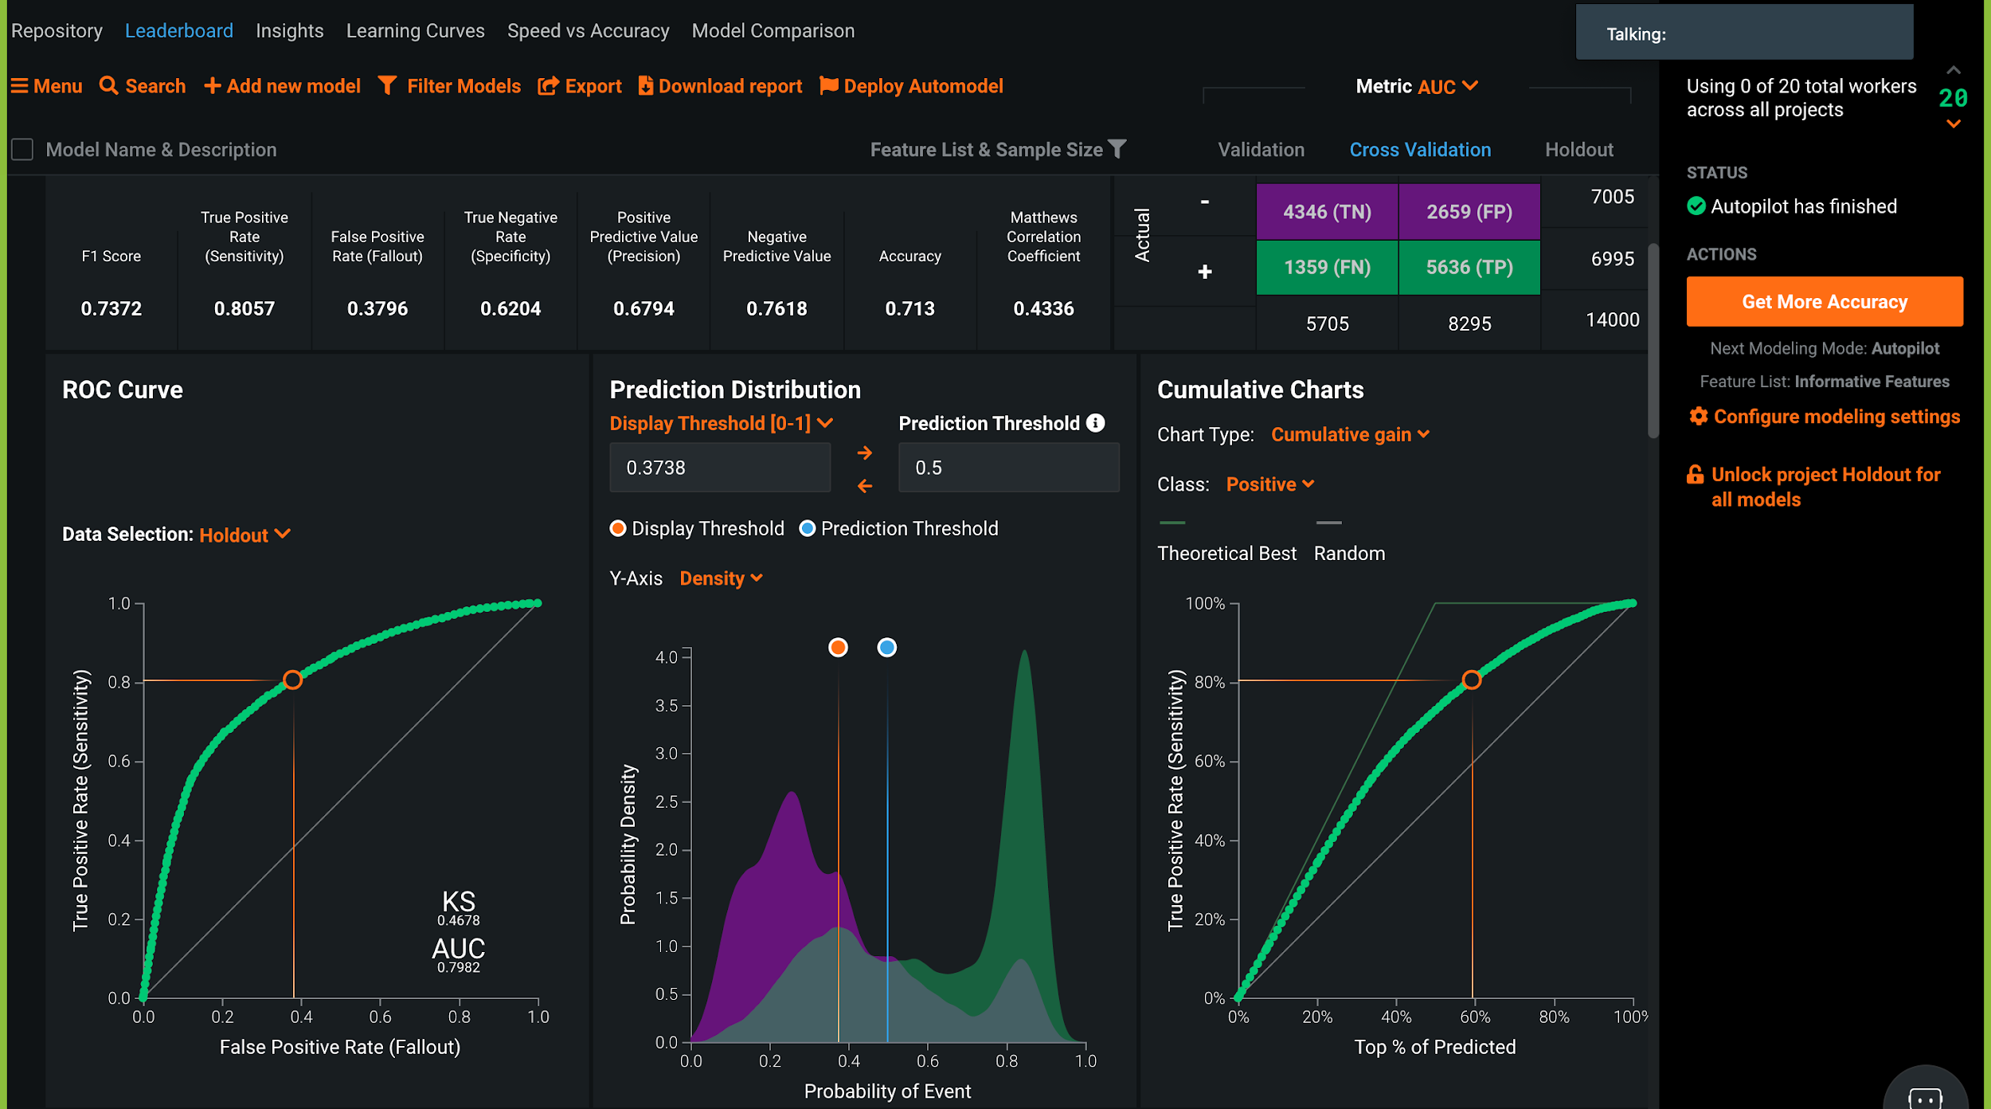
DATA ROBOT AI
ONCE YOU CLICK THE EVALUATION TAB, UNDER THE ABOVE MODEL, YOU CAN SEE DIFFERENT WAYS TO EVALUATE THE MODEL.
HERE, YOU CAN SEE AUC, CONFUSION METRIC AND PREDICTION DISTRIBUTION.

Slide 39
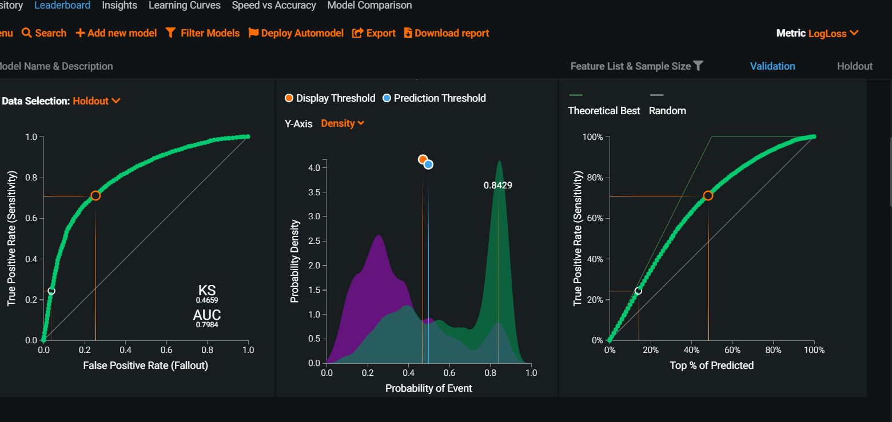
DATA ROBOT AI
GREAT RESOURCE BY JASON BROWNLEE: HTTPS://MACHINELEARNINGMASTERY.COM/THRESHOLD-MOVING-FOR-IMBALANCED-CLASSIFICATION/
IF YOU SET THE THRESHOLD TOO HIGH, YOU WILL BECOME SUPER SELECTIVE, MEANING YOUR RECALL (TRUE POSITIVE RATE)~0 BUT YOUR FALSE POSITIVE RATE WILL REDUCE DRAMATICALLY AS WELL (YOU WON’T MAKE MANY MISTAKES)

Slide 40
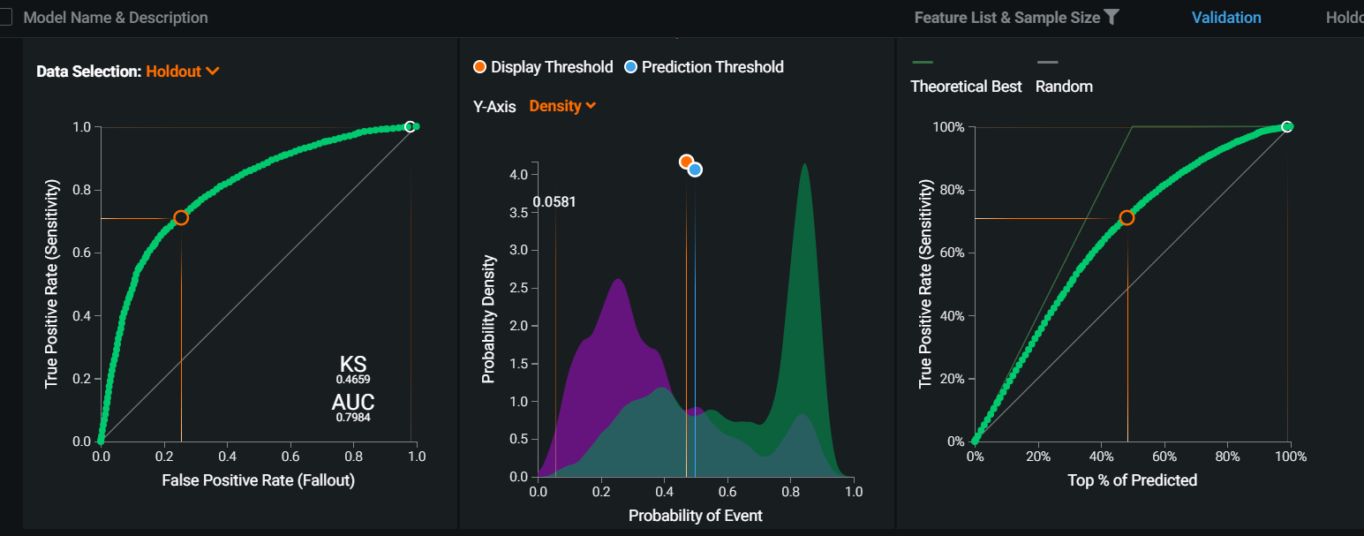
DATA ROBOT AI
GREAT RESOURCE BY JASON BROWNLEE: HTTPS://MACHINELEARNINGMASTERY.COM/THRESHOLD-MOVING-FOR-IMBALANCED-CLASSIFICATION/
IF YOU SET THE THRESHOLD TOO LOW, YOU WILL NOT BECOME SELECTIVE ANYMORE AND MOST DATA POINTS WILL BE CLASSIFIED AS 1, MEANING YOUR RECALL (TRUE POSITIVE RATE) WILL BE EQUAL ONE (BECAUSE YOU HAVE DETECTED ALL CARDIVASCULAR CASES) BUT YOUR FALSE POSITIVE RATE WILL INCREASE DRAMATICALLY AS WELL (YOU WILL MESS UP TOO MUCH AND MAKE MANY MISTAKES).

Slide 41
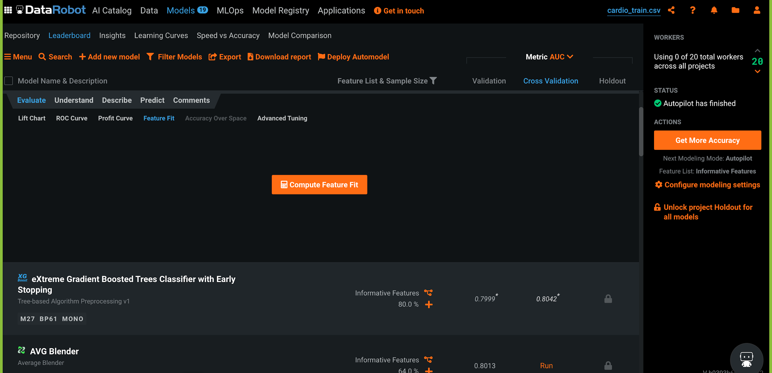
DATA ROBOT AI
TO EVALUATE FEATURE FIT OF THE MODEL, CLICK ON THE COMPUTE FEATURE FIT BOX

Slide 42
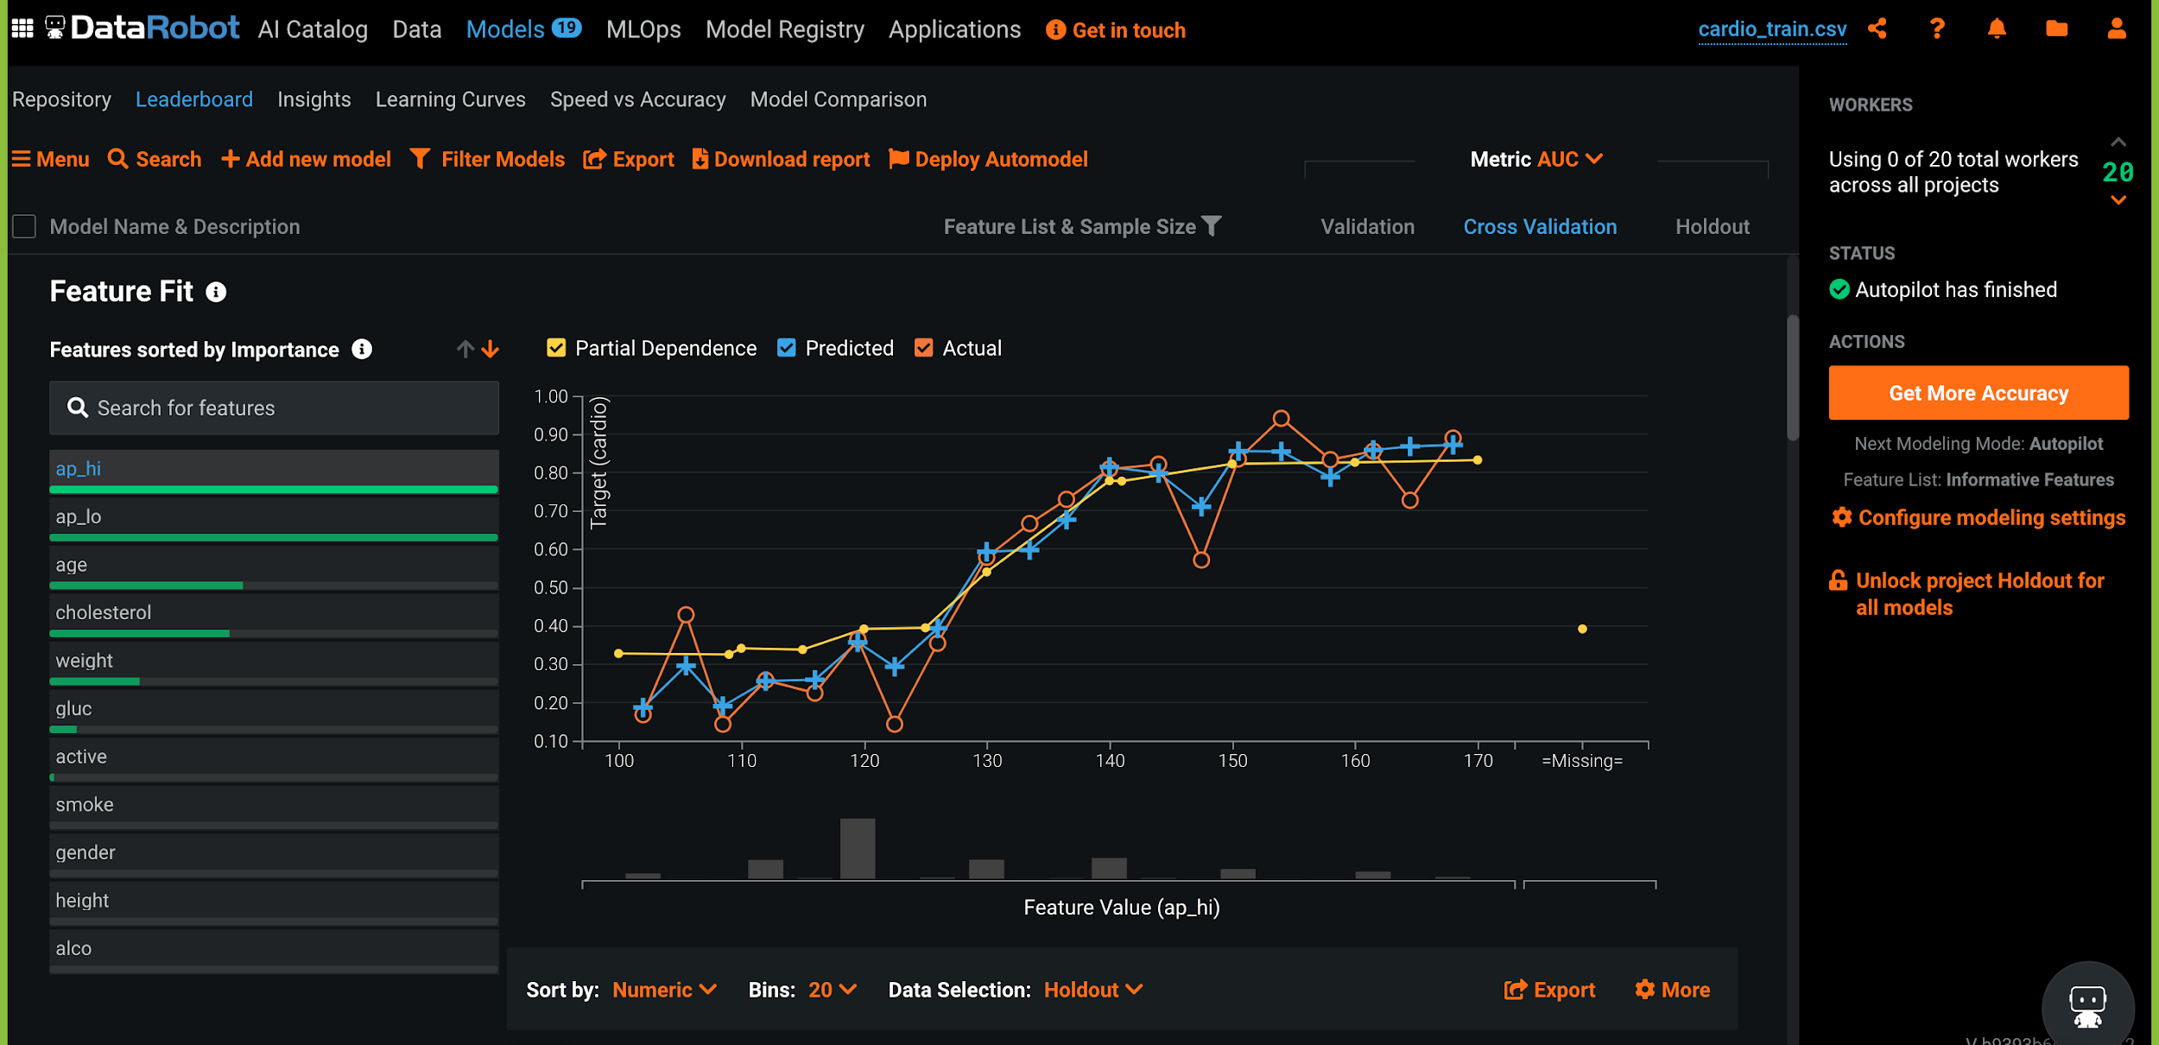
DATA ROBOT AI

Slide 43
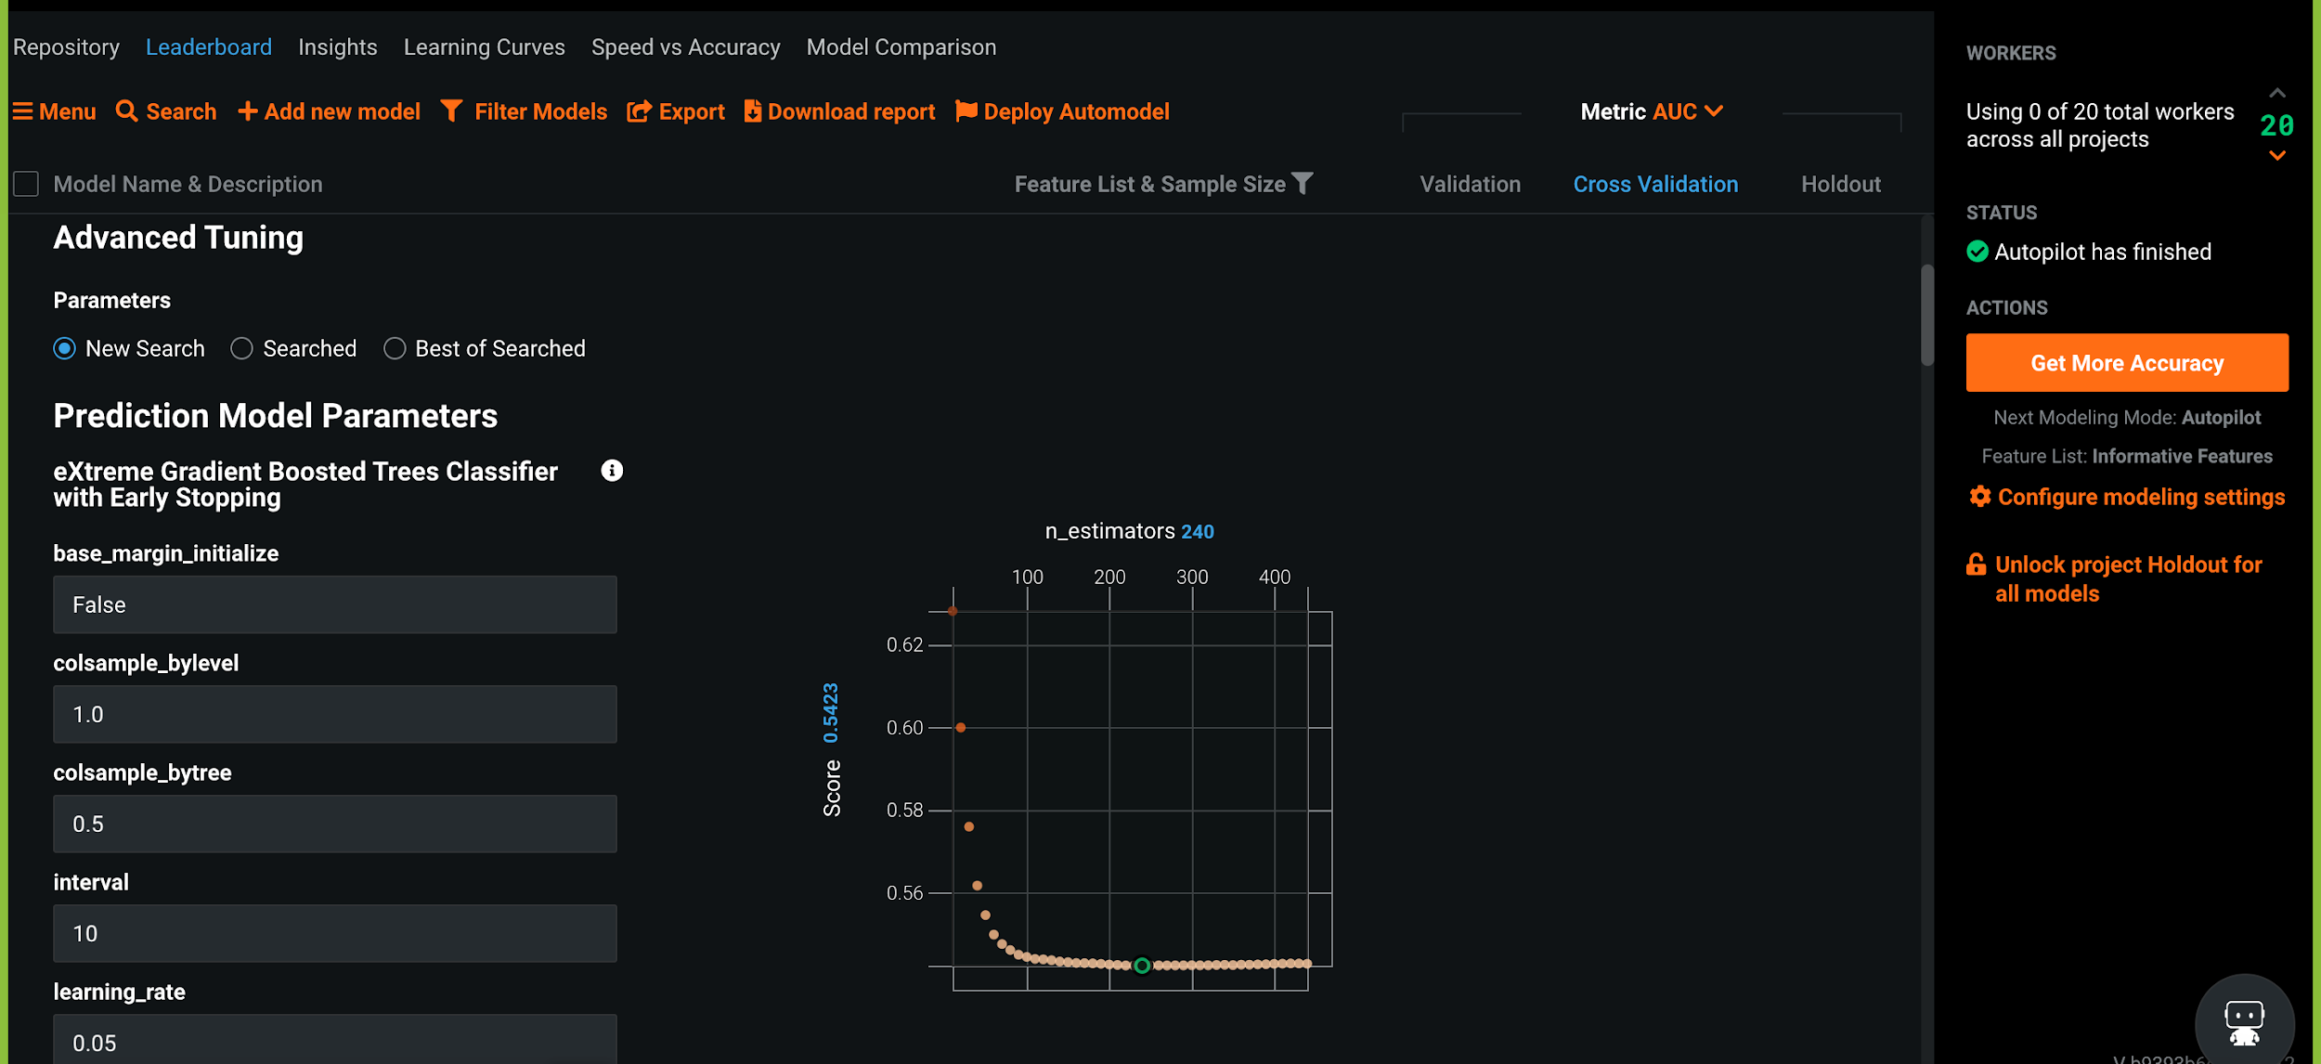
DATA ROBOT AI
YOU CAN TUNE THE HYPERPARAMETERS BY CLICKING ON ADVANCED TUNING OPTION. YOU CAN SPECIFY THE VALUES OF PREDICTION PARAMETER.

Slide 44
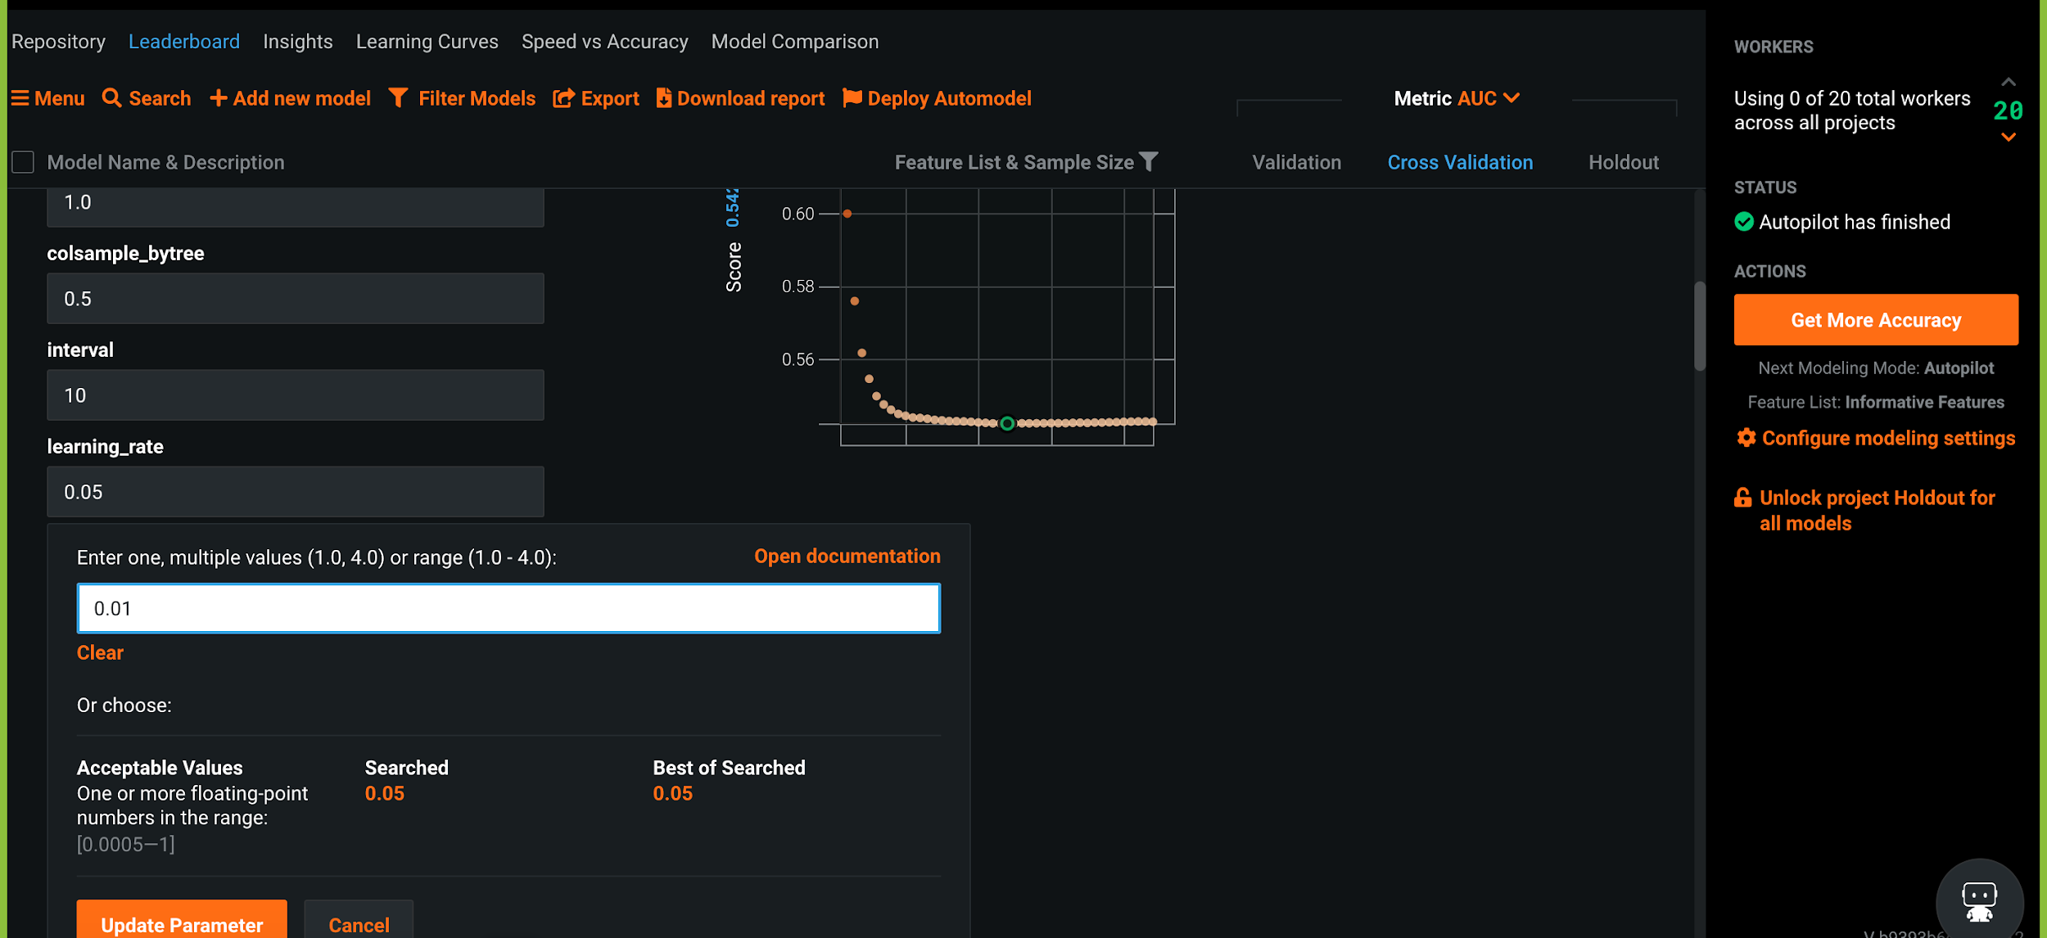
DATA ROBOT AI
ONCE YOU MAKE CHANGES TO THE PARAMETER, CLICK ON UPDATE PARAMETER.

Slide 45
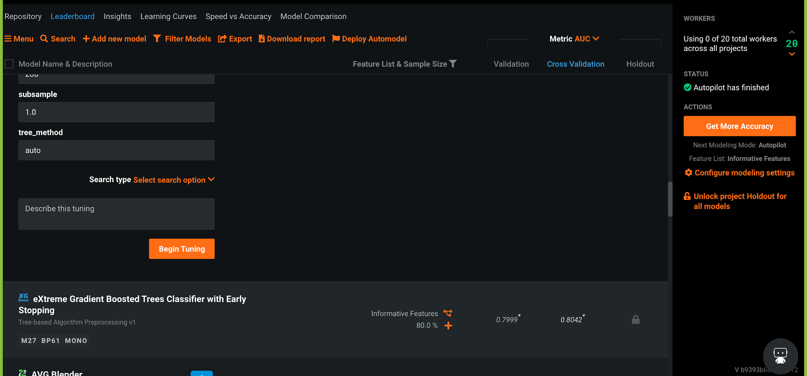
DATA ROBOT AI
CLICK ON BEGIN TUNING TO START HYPER PARAMETER TUNING.

Slide 46
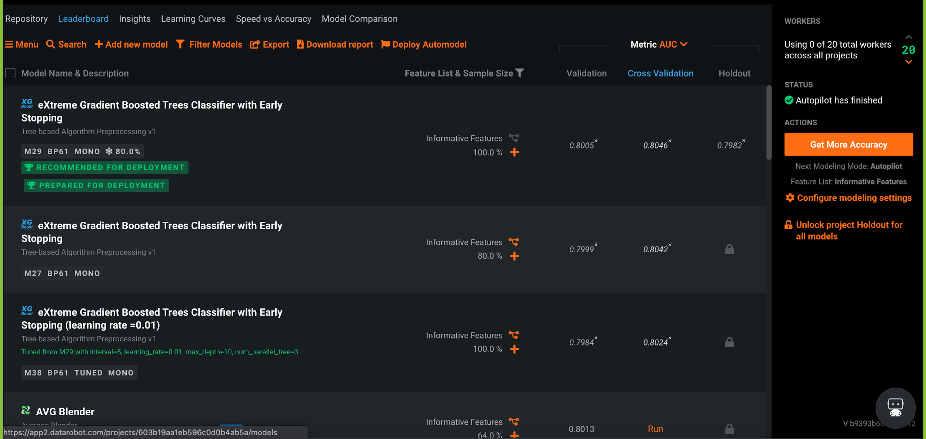
DATA ROBOT AI
EVEN AFTER PARAMETER TUNING, THE INITIAL MODEL SEEMS TO BE PERFORMING WELL, SO WE ARE STICKING WITH THE ORIGINAL MODEL.

Slide 47
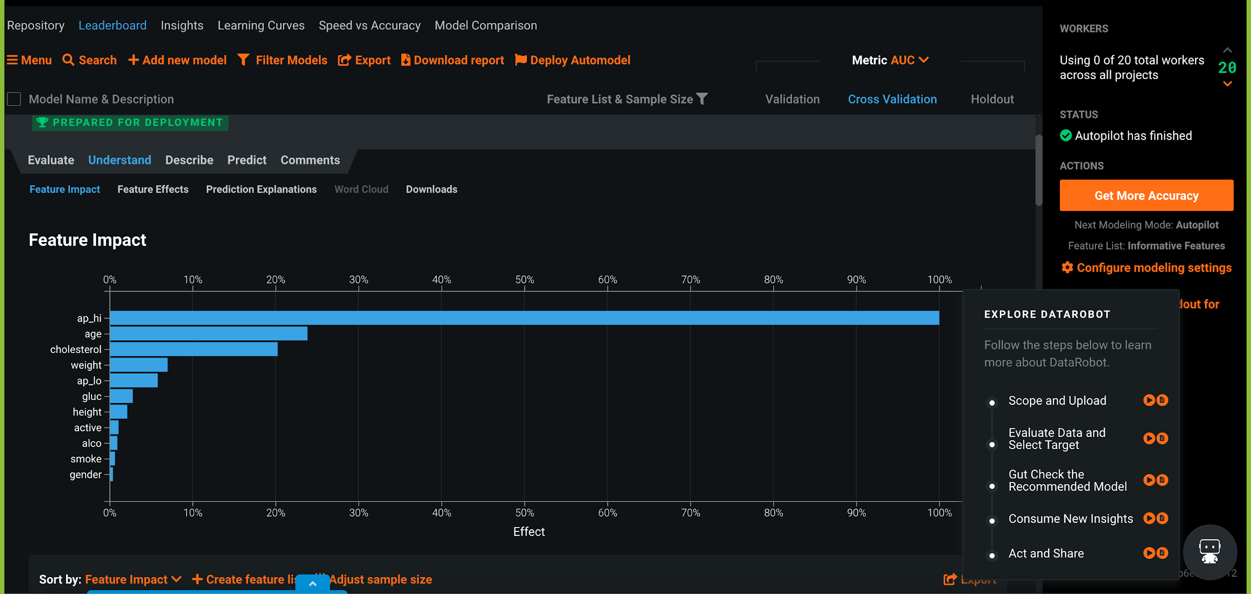
DATA ROBOT AI
FOR EXPLAINABILITY PURPOSE, WE ARE LOOKING AT FEATURE IMPACT, EFFECTS, PREDICTION EXPLANATION ETC.,

Slide 48
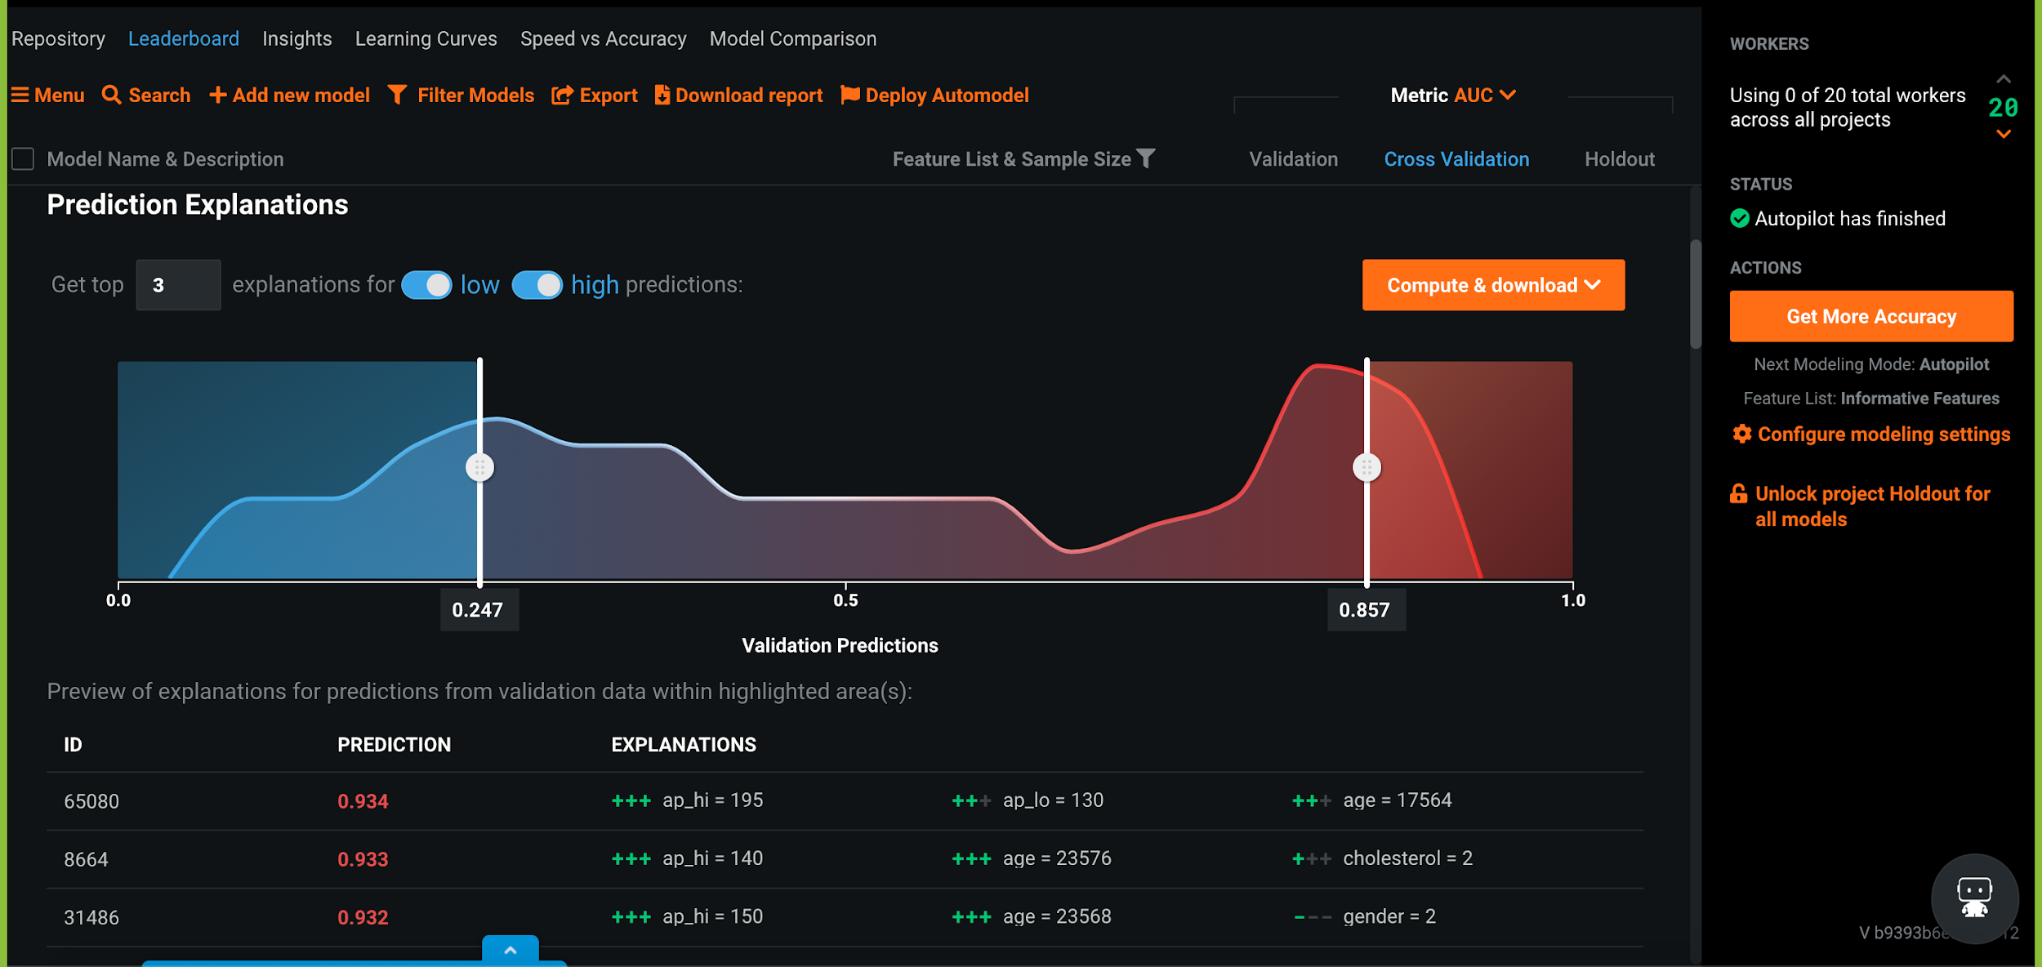
DATA ROBOT AI

Slide 49
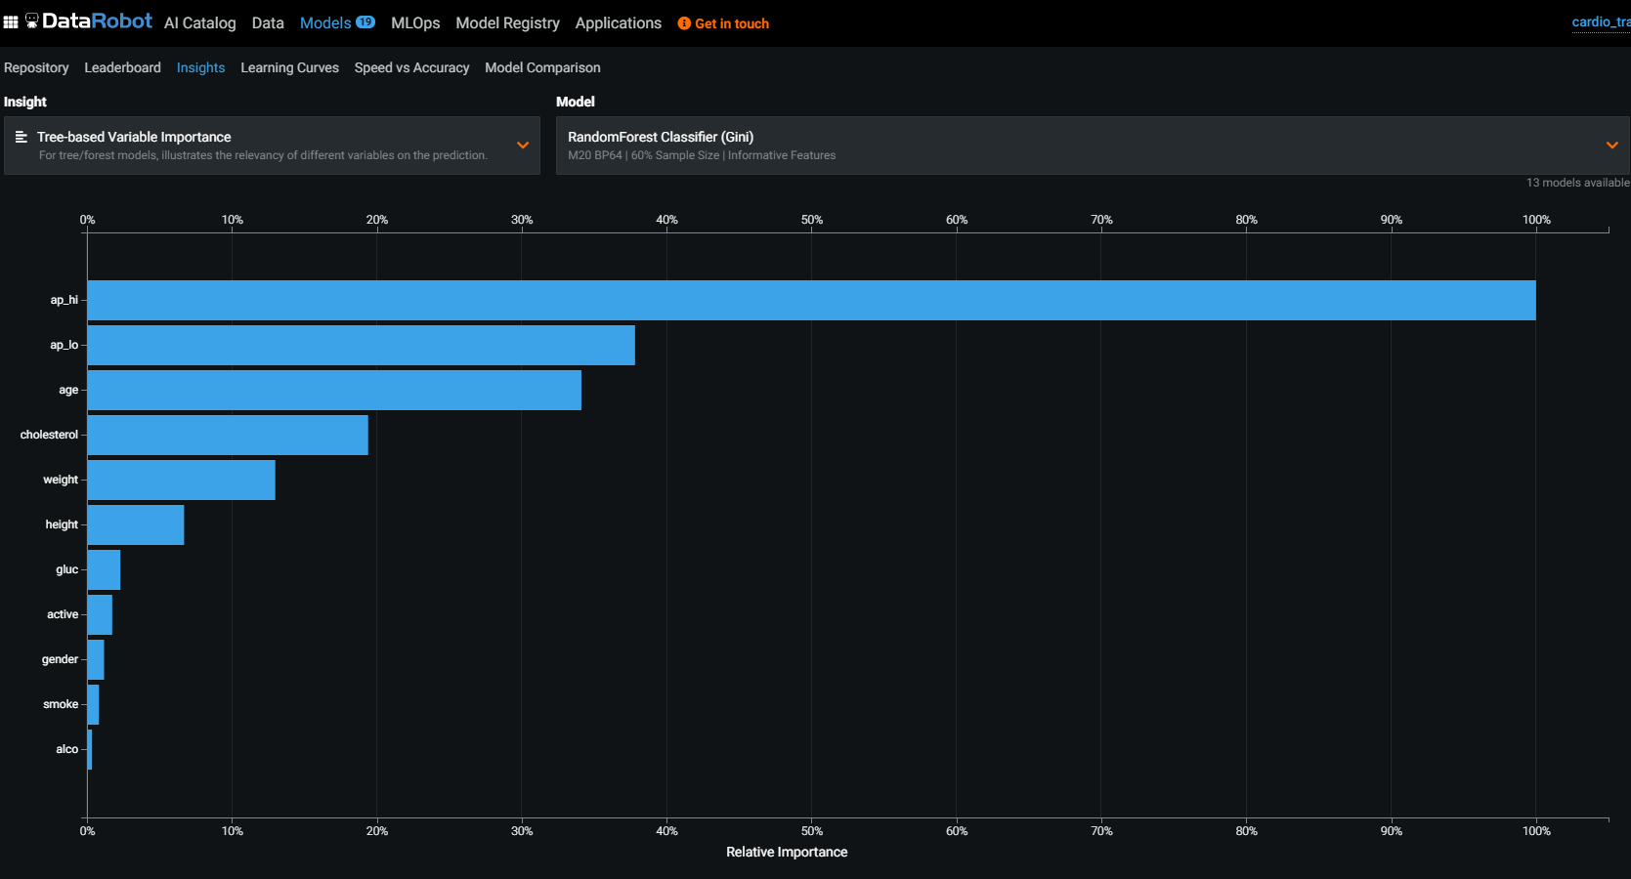
DATA ROBOT AI
TO BETTER UNDERSTAND THE MODEL, CLICK ON THE INSIGHT OPTION.

Slide 50
DATAROBOT AI DEMO – PART #5: MODEL DEPLOYMENT & MAKING INFERENCE
EASY
ADVANCED

Slide 51
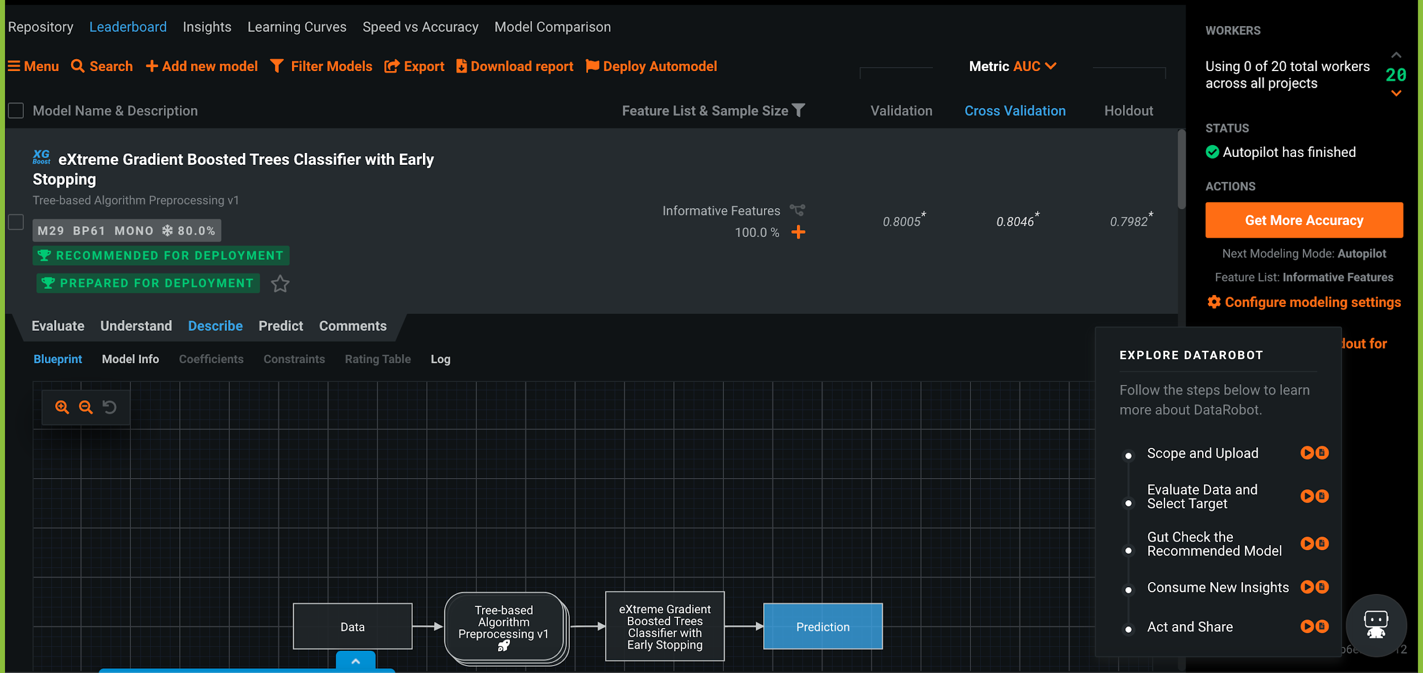
DATA ROBOT AI
TO DEPLOY THE MODEL, CLICK ON THE DEPLOY AUTOMODEL OPTION ON THE TOP

Slide 52
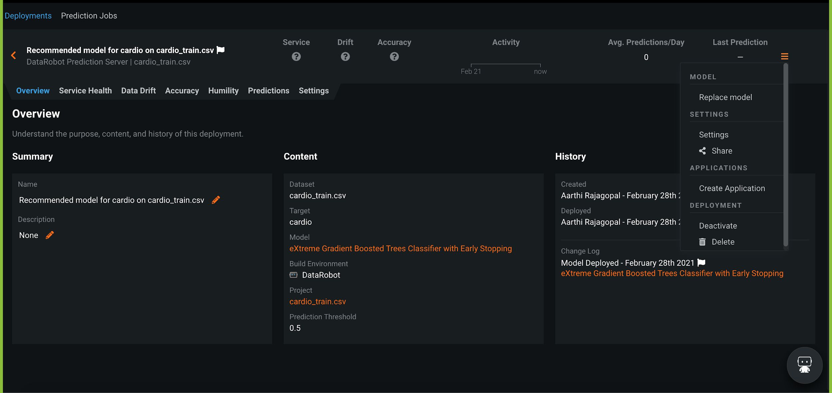
DATA ROBOT AI
AFTER DEPLOYING THE MODEL, CLICK ON THE CREATE APPLICATION OPTION.

Slide 53
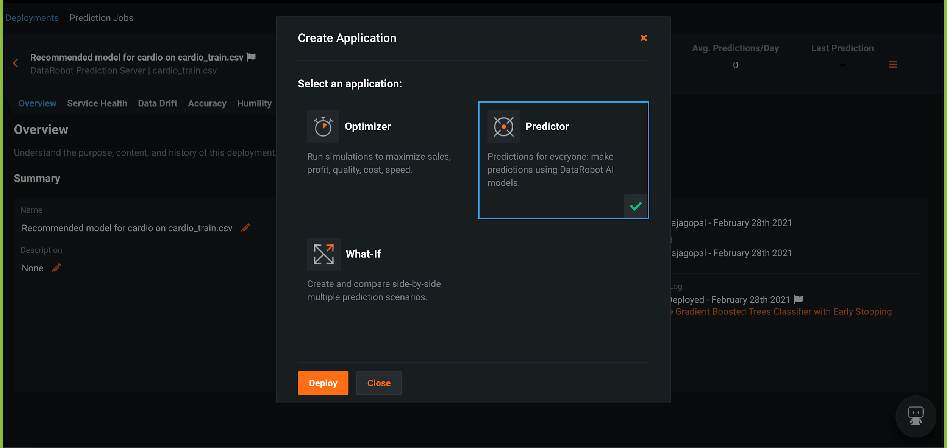
DATA ROBOT AI
CLICK THE PREDICTOR OPTION AND THEN DEPLOY IT.

Slide 54
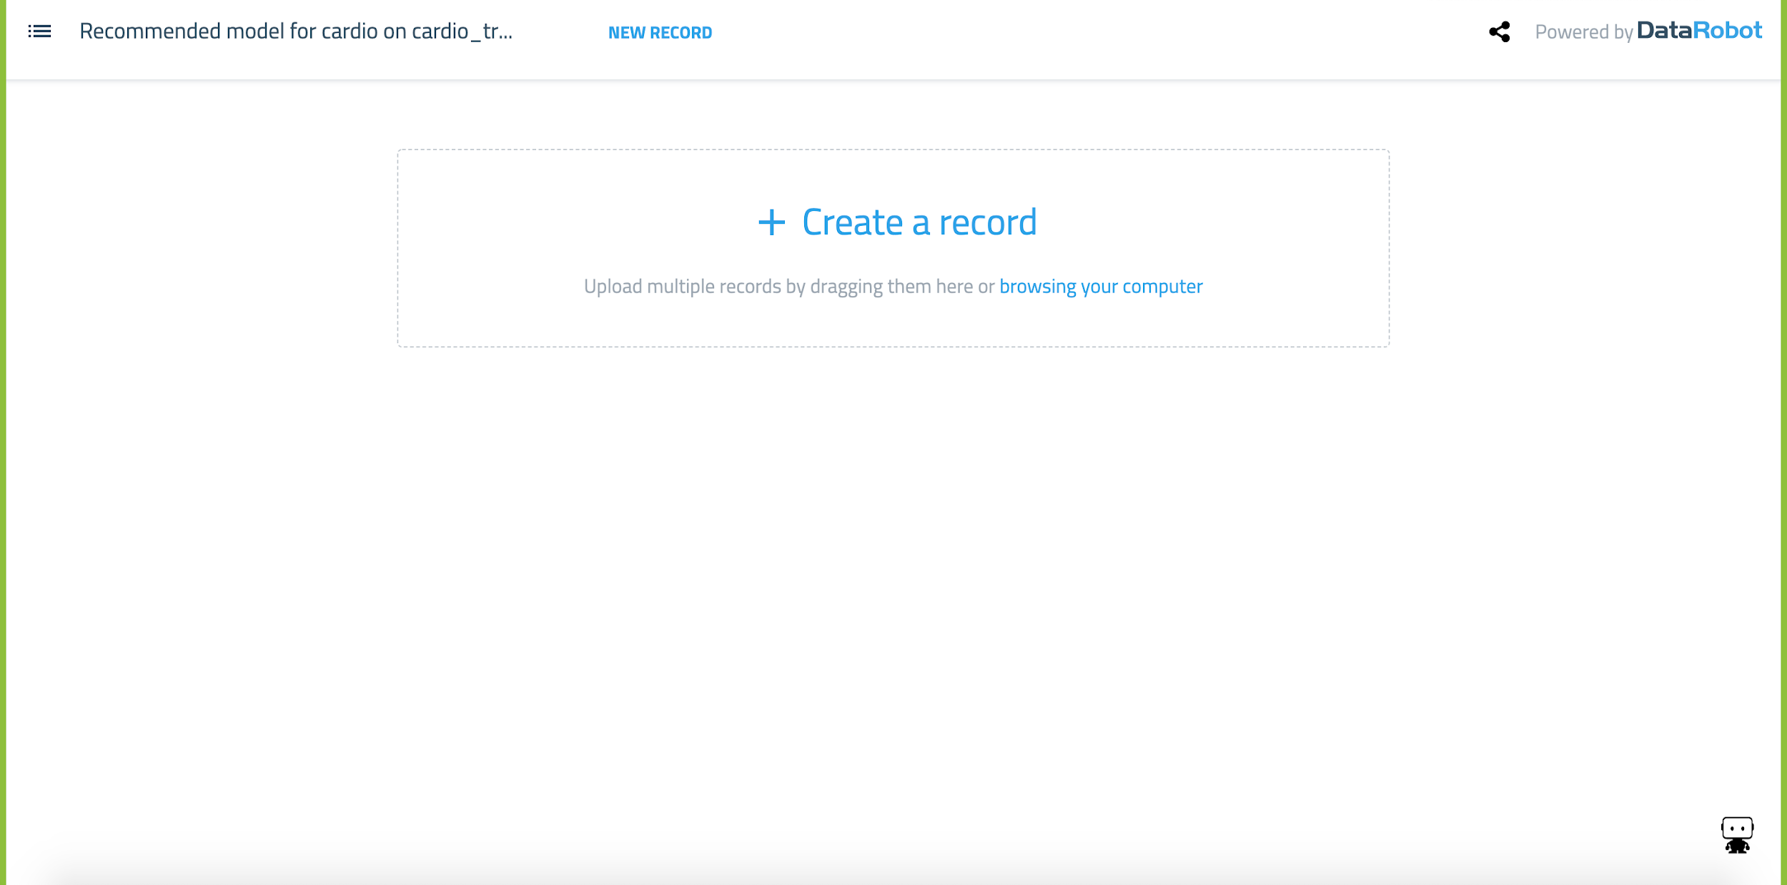
DATA ROBOT AI
YOU WILL ARRIVE AT THIS PAGE AFTER DEPLOYING THE PREDICTOR.

Slide 55
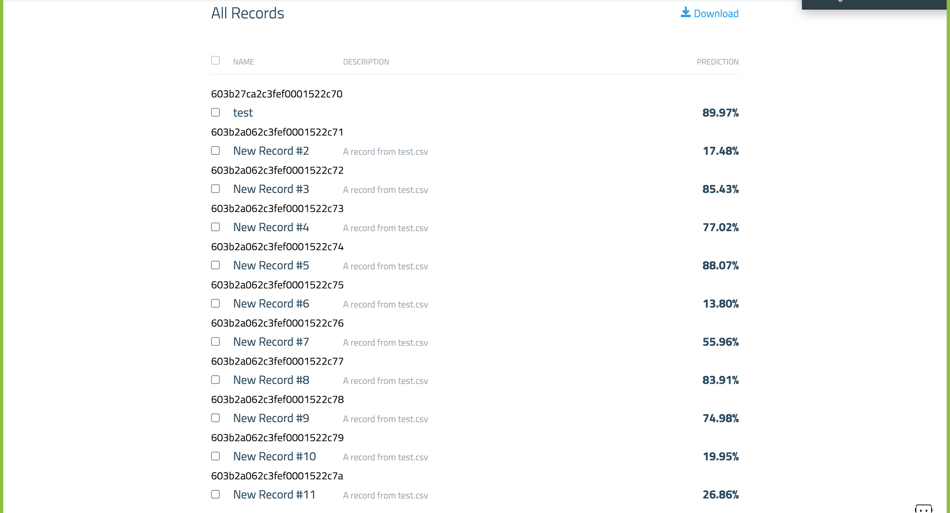
DATA ROBOT AI
ONCE YOU DRAG AND DROP THE INFERENCE FILE, YOU CAN SEE THE MODEL PERFORMING INFERENCE ON THE RECORDS IN THE FILE

Slide 56
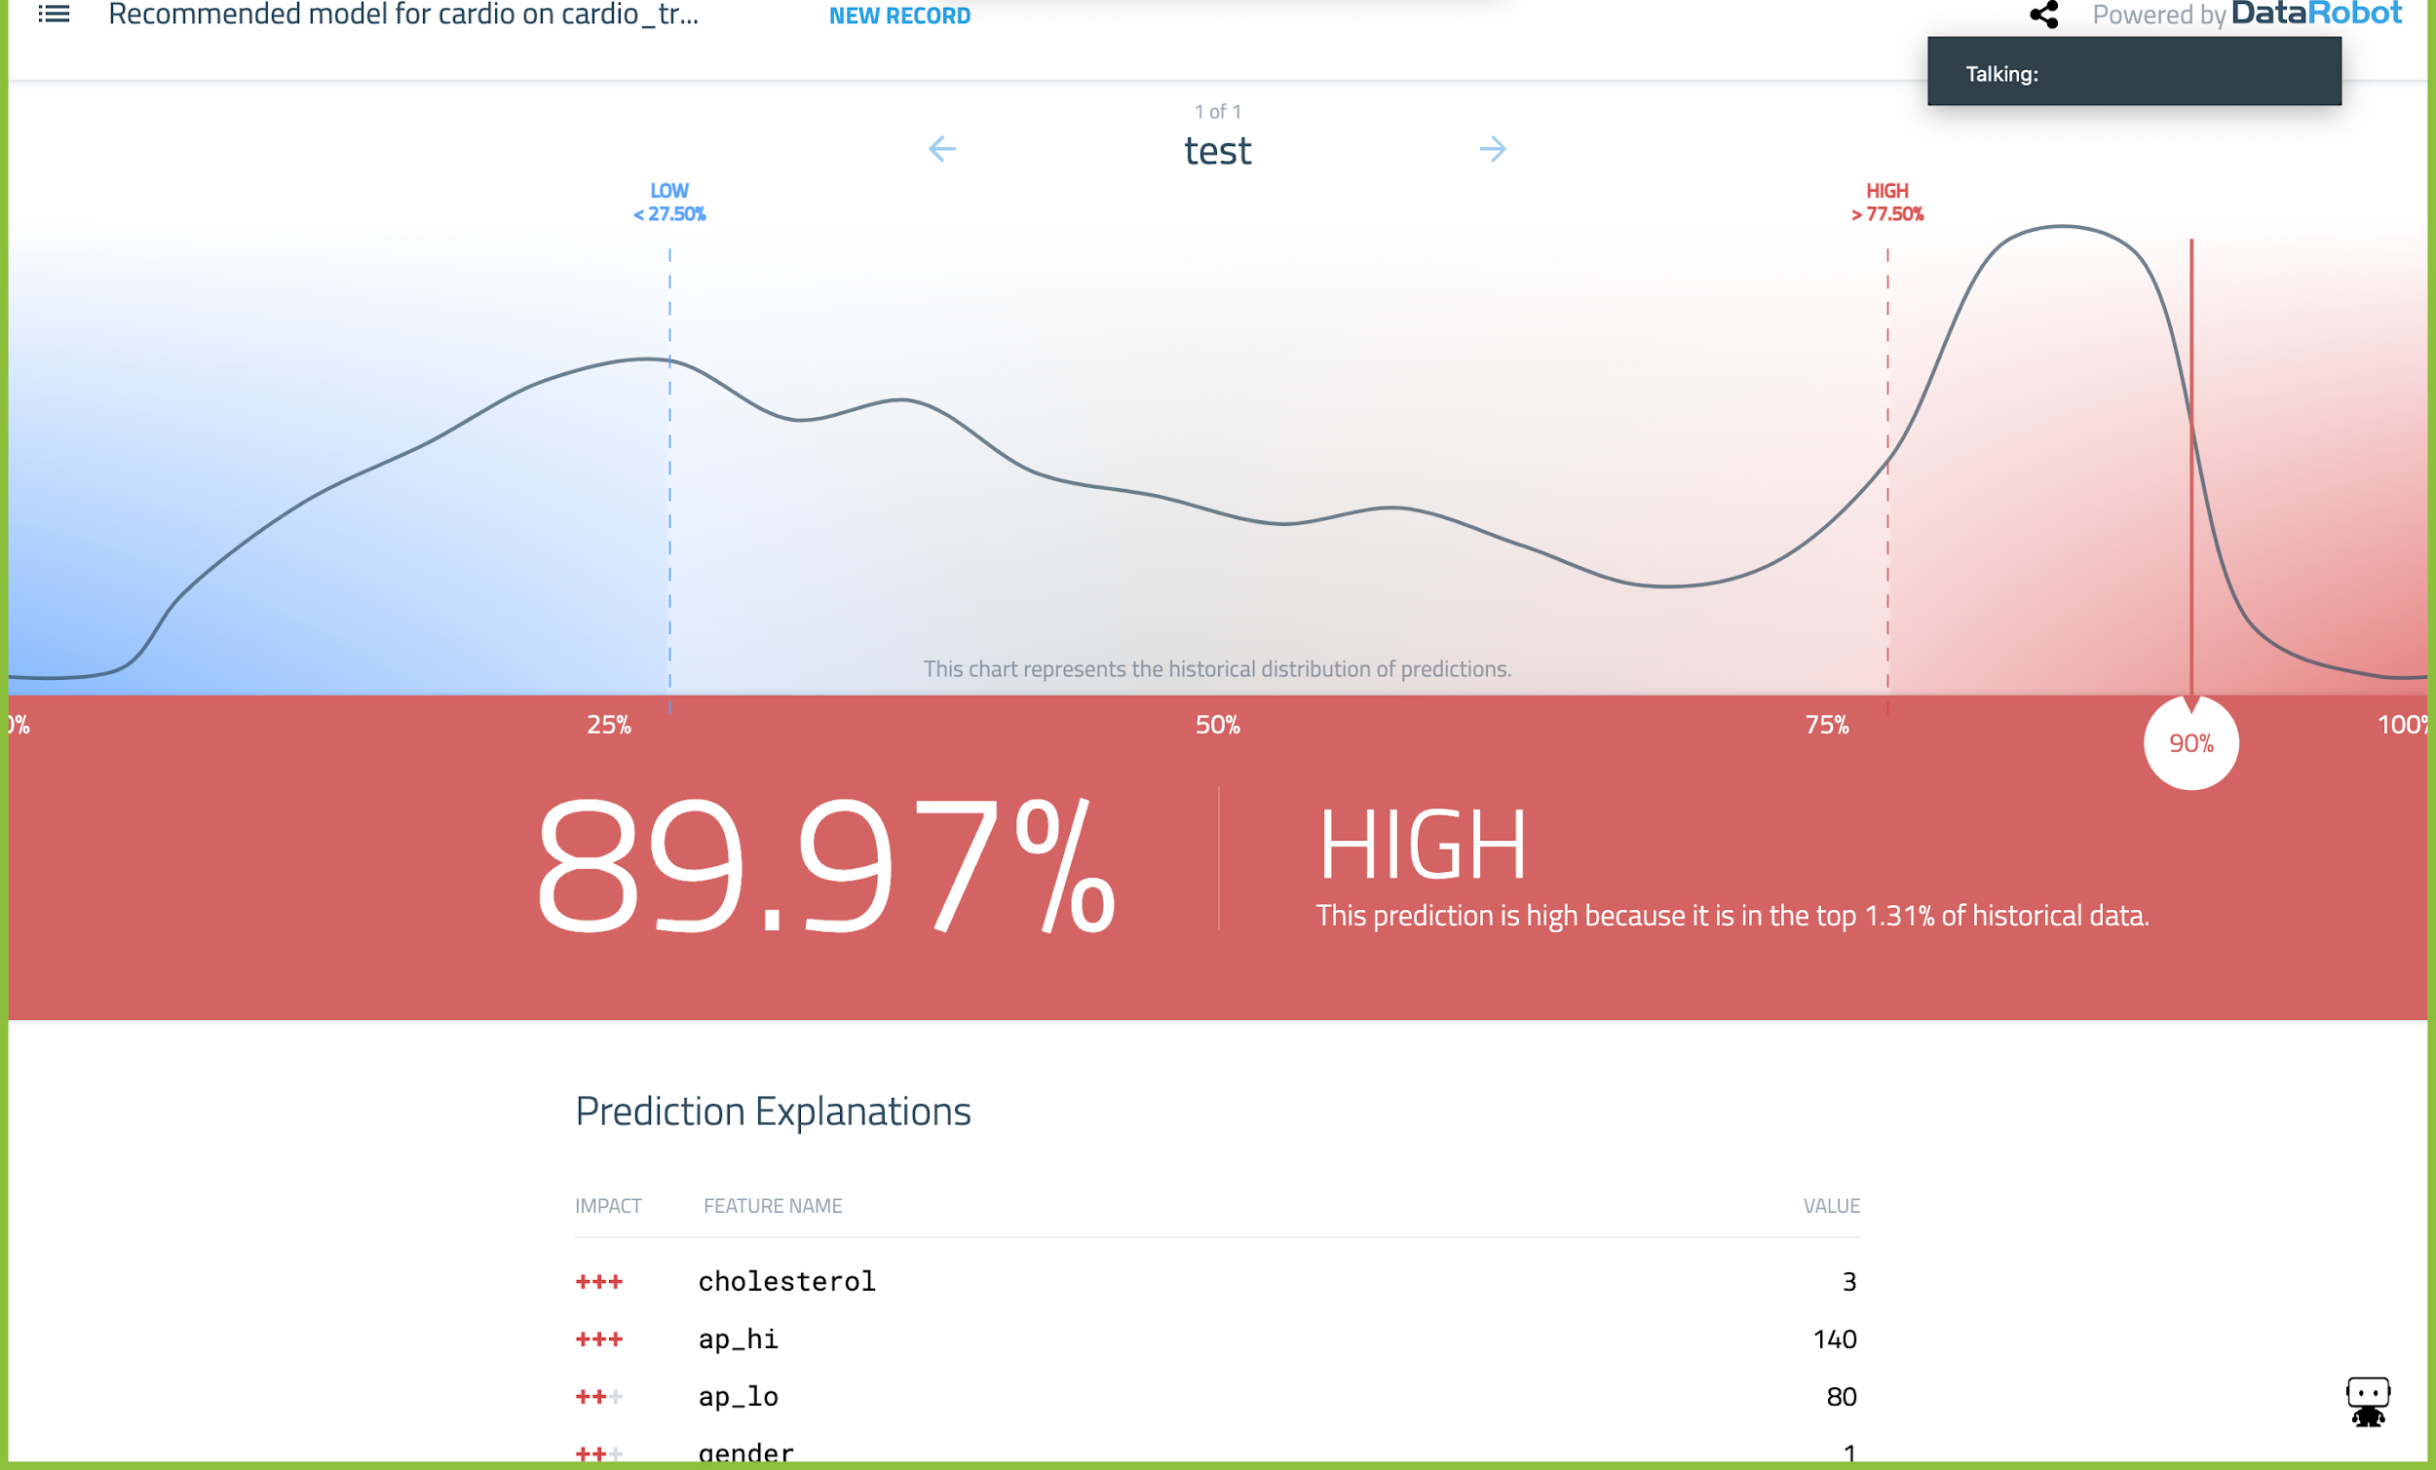
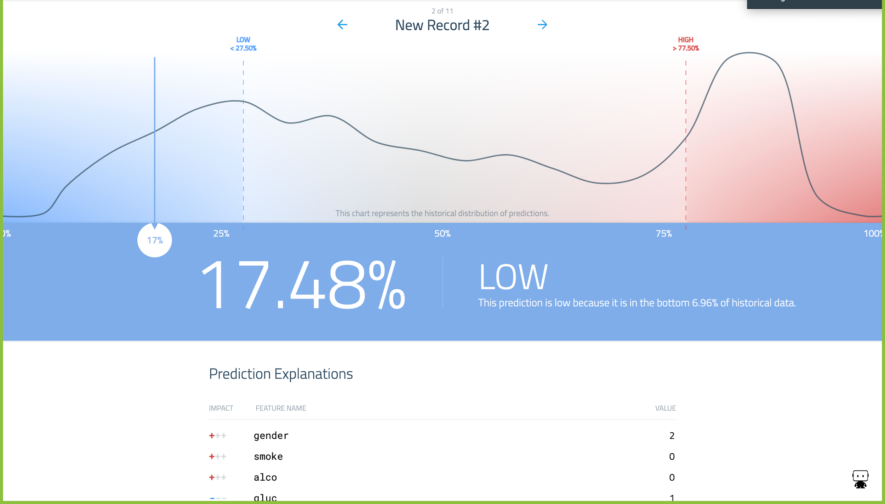
DATA ROBOT AI
ONCE YOU CLICK ON THE INFERENCE RECORD, IT WILL SHOW IF THAT RECORD HAS A HIGH OR LOW CHANCE OF GETTING CARDIOVASCULAR DISEASE.

Slide 57
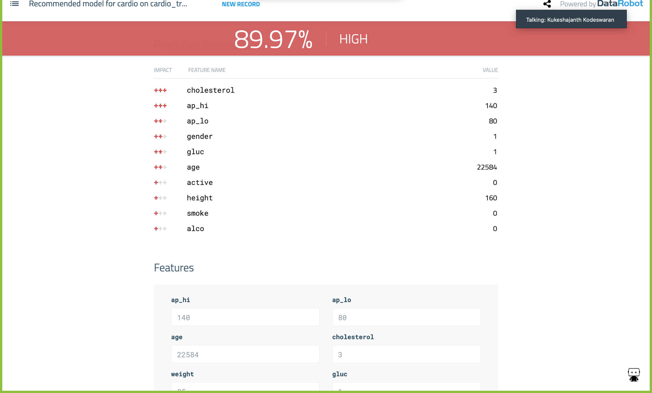
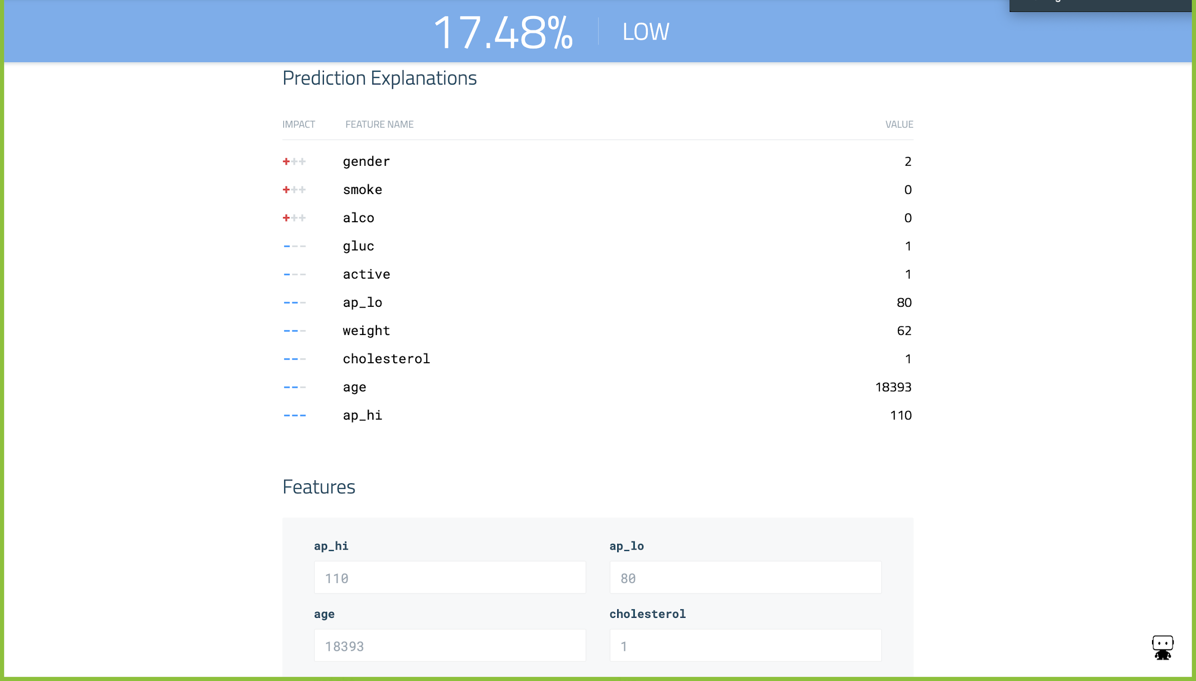
DATA ROBOT AI
WE CAN ALSO SEE THE REASON WHY THE MODEL HAS CHOSEN WHETHER A PERSON HAS HIGH OR LOW CHANCE OF GETTING CARDIO-VASCULAR DISEASE.

